Slide 1
Altus AFB
Contractors General Environmental Management Awareness Training
Updated NOV 2023
OPR: 97 CES/CEIE
97 CES Environmental

Slide 2
Course Content
Description
This course is designed to provide you with an overview of base specific environmental information for personnel that fall under the Altus AFB Environmental Management System (EMS). Intended to augment the Air Force EMS General Awareness Training available on myLearning and TEACH.
Objective
Upon completion of this course, you will understand the environmental requirements that ALL Altus AFB employees must adhere to in order to conform to the
97 AMW/CC Environmental Vision/Commitment Statement

Slide 3
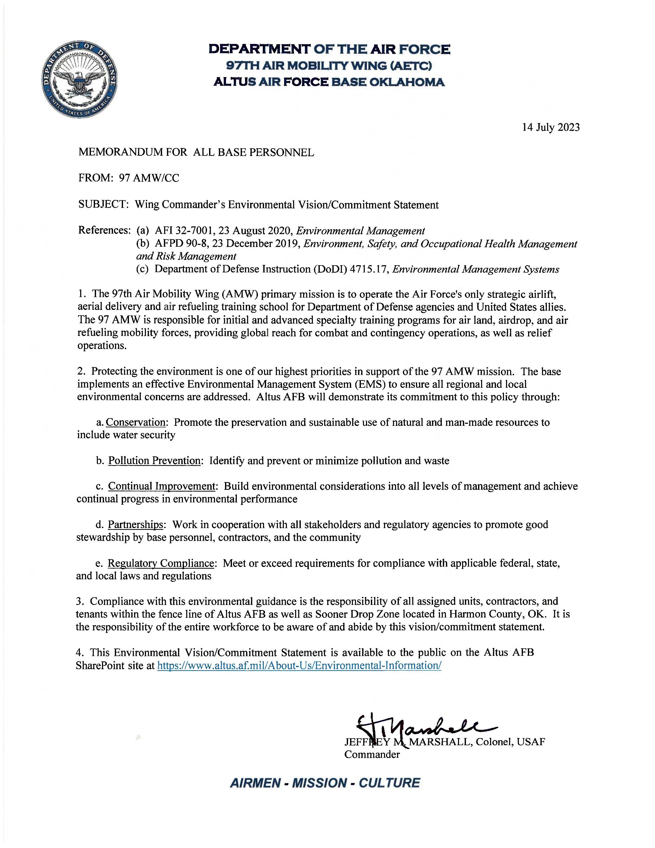
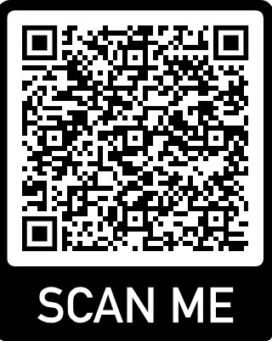
Wing Commander’s Environmental Vision/Commitment Statement
A. Conservation: Promote the preservation and sustainable use of natural and man-made resources
B. Pollution Prevention: Identify and prevent or minimize pollution and waste
C. Continual Improvement: Build environmental considerations into all levels of management and achieve continual progress in environmental performance
D. Partnerships: Work in cooperation with all stakeholders and regulatory agencies to promote good stewardship by base personnel, contractors and the community
E. Regulatory Compliance: Meet or exceed requirements for compliance with applicable federal, state, and local laws and regulations

Slide 4
Department of Air Force Instructions & Manuals (DAFI / DAFMAN)
Environmental Management falls under Civil Engineering and follows 32-series DAFIs (i.e., 32-XXXX)
DAFI / DAFMAN | Title
DAFI 32-7001 | Environmental Management
DAFMAN 32-7002 | Environmental Compliance and Pollution Prevention
DAFMAN 32-7003 | Environmental Conservation
DAFI 32-7020 | Environmental Restoration Program
DAFMAN 32-1067 | Water and Fuel Systems

Slide 5
Local Environmental Regulations
Environmental Management operates under various base specific plans and state permits
Plans/Permits | Title
Pest Management | Integrated Pest Management Plan
Solid Waste | Integrated Solid Waste Management Plan
Hazardous Waste | Hazardous Waste Management Plan
Hazardous Materials | Hazardous Materials Management Plan
SWPPP | Storm Water Pollution Prevention Plan
SPCC/FRP | Spill Prevention, Control, Countermeasure Plan/ Facility Response Plan
Asbestos | Asbestos Management & Operations Plan
Lead Based | Lead-Based Paint Management & Operations Plan
Restoration Permit | ODEQ RCRA Corrective Action Permit
Air Permit | ODEQ Minor Source Operating Permit
Storm Water Permit | OPDES Multi-Sector General Permit OKR05
Wastewater Discharge | City of Altus Wastewater Discharge Permit

Slide 6
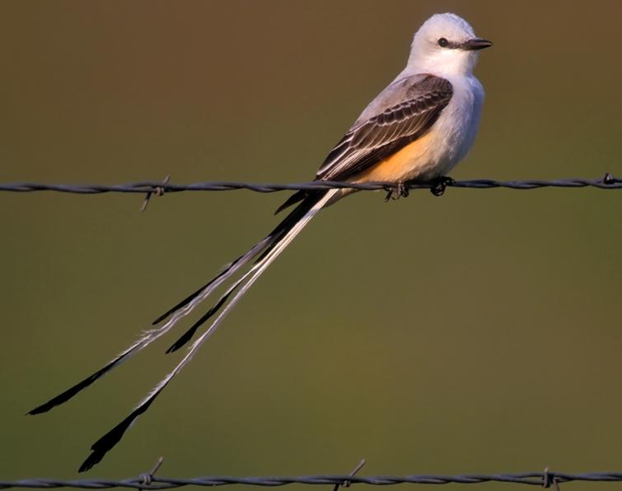


Altus AFB Environmental Attributes
8,016 acres of land
1,434 acres of Wetland
29 Restoration sites
    Land use controls (restricted digging)
537 tons/yr - Solid Waste – 51% recycled
Personnel
    2,583 Military/Dependents
    1,811 Civilians
    1,012 Retirees
0 Historic bldgs and 2 National Registry eligible bldgs
158 Air sources
4M gal fuel stored; 82 ASTs
24 tons/yr Regulated waste generated
26K containers of HazMat managed annually
“Scissor-Tailed Flycatcher”
“Oklahoma Rose”
“Indian Blanket”

Slide 7
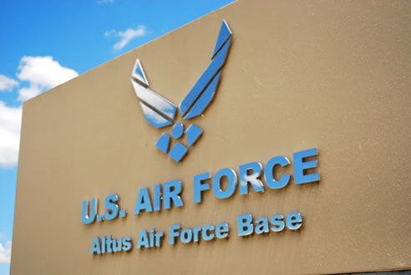
Altus AFB Environmental Risk/Aspect
Altus AFB Environmental Programs with Risks and Costs
Hazardous Materials
Air Quality
Wastewater
Natural Resources
Fuels; Tanks; Petroleum, Oils, & Lubricants
Hazardous Waste
Environmental Impact Analysis Process
Drinking Water
Storm Water
Solid Waste
Environmental Noise
Cultural Resources
Toxic Materials (Asbestos, Lead-based Paint [LBP], Polychlorinated Biphenyl [PCB] )
Green Procurement
Pest Management
Recycling

Slide 8

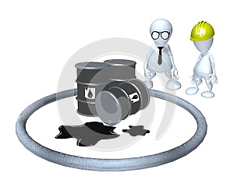

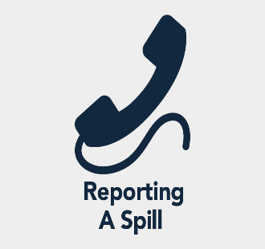
Spill Reporting
Spills, Discharges, & Releases
Hazardous Material/Waste
Water/Sewage/Industrial Wastewater
Oil/Lubricants
Fuel
Contact/Report Immediately:
For any spill, discharge, or releases
Nothing other than clean water can enter a storm drain
Link to spill report form:
https://usaf.dps.mil/:w:/r/teams/10625/Altus/_layouts/15/Doc.aspx?sourcedoc=%7BC05ADD67-4AF1-4022-9C15-50E10264D63A%7D&file=Altus%20AFB%20Spill%20Report%20Form%202021.docx&action=default&mobileredirect=true
Call
911
Emergency number from your cell phone:
580-481-6333 (Fire Dept)

Slide 9
Solid Waste Management
Your contracts Environmental Protection Plan, Solid Waste Management Plan, Stormwater Pollution Prevention Plan must be followed if applicable.
If your contract was not required to submit any environmental management plans the below practices should be adhered to while working on Altus AFB.

Slide 10


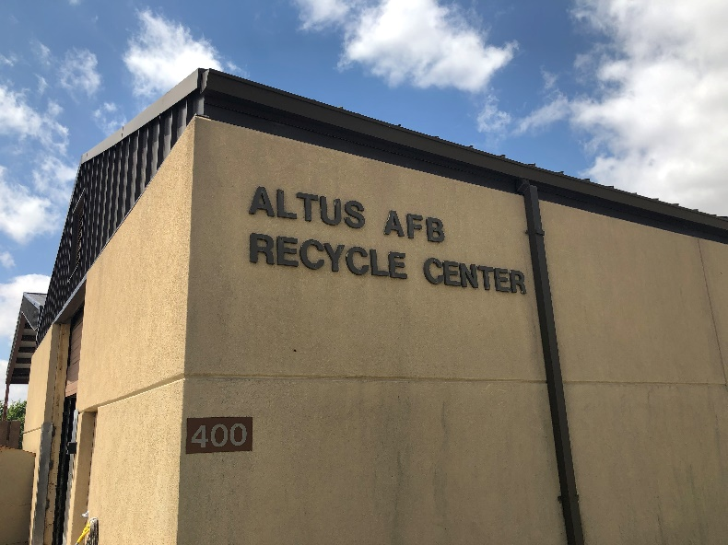
What CAN be recycled at the Recycling Center?
YES
NO
Aluminum / Tin Cans
Plastics (# 1 & # 2) (bagged)
Mixed Paper / Magazines / Newspaper
Cardboard
Shredded Paper (Must Be BAGGED)
Scrap Metal
Lead Acid Batteries
Rechargeable Batteries
Laser/Ink Jet Printer Cartridges
Light Bulbs
Oil (Auto Hobby Shop can take used oil)
Tires
Wood
Pallets (roll off dumpster at bldg 400)
Paint (contact HW PM)
Clothing (Airman’s Attic)
Furniture (Airman’s Attic)
Construction debris
Glass
Questions??
Call 481-7698 or 481-6221

Slide 11

Recycling Center Building 400
Recycle Center # 580-481-7698
Compost
Altus AFB Community
Garden
Must Contact Environmental to ensure space availability
Building 400
White & Mixed Paper/
Cardboard
MANDATORY per DODI
Building 400
#1 & #2 Plastic
Ensure containers are empty & MUST be Bagged
Building 400
*Lithium Ion
*Nickel-Cadmium (NiCad)
*Nickel Metal Hydride
RECYCLED: Lead Acid
Building 400
Steel & Aluminum Cans
Building 400
Scrap Metals/
Copper Wire
Lithium Ion and NiCad are considered Universal Waste
*** 90-day turn-in timeframe to building 400 ***

Slide 12
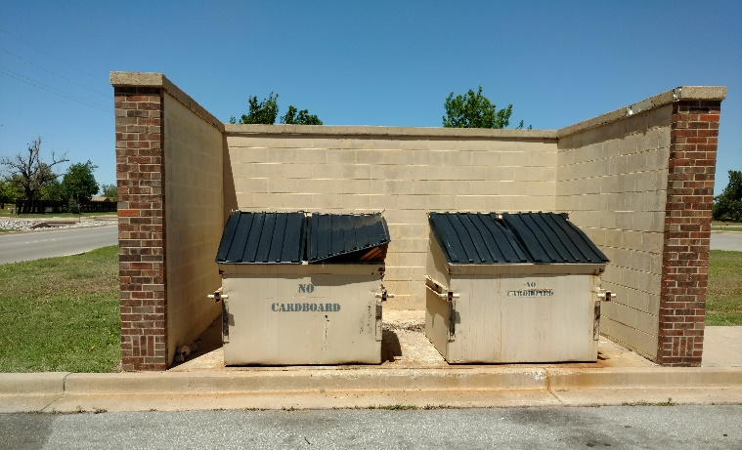
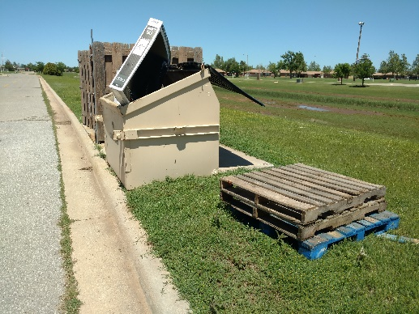


Community Dumpsters – Do YOUR part!
The area around the dumpsters MUST remain free of trash or items that may interfere with the placement of the dumpster
VIOLATIONS prevent the dumpster from being emptied.
Ex. Items sticking out of dumpsters. Pieces of wood must not be stored inside!

Slide 13
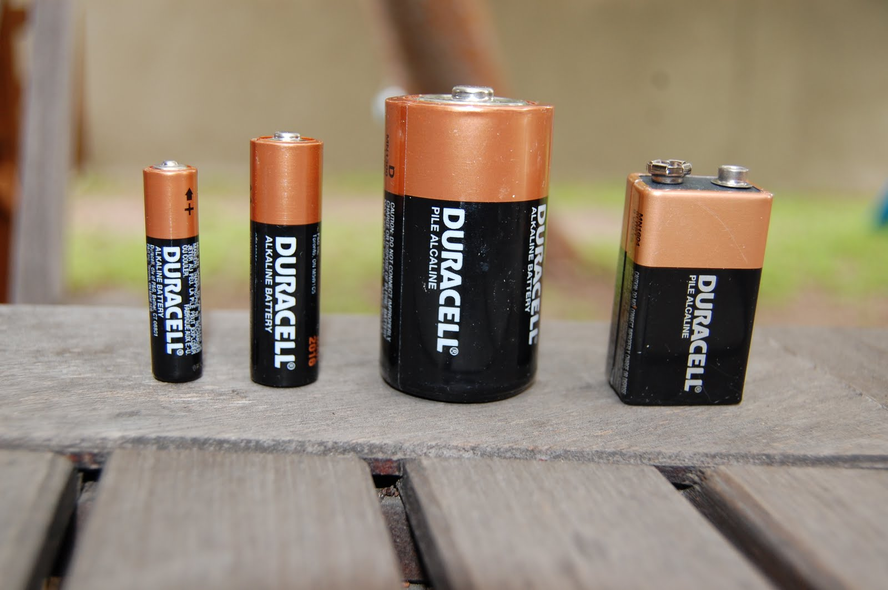
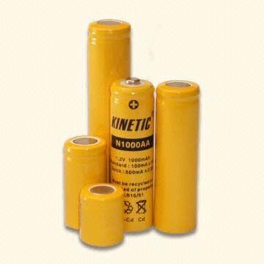
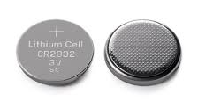
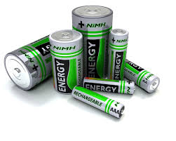
Which batteries can go in the trash?
C
A
B
D
A. AA, AAA, C, D & 9V batteries can go into the trash
Universal waste must be turned in to building 400 same day unless approved by 97 CEIE to store.
B. NiCad are batteries and must be managed as Universal Waste
C. Lithium batteries are Universal Waste
D. Nickel Metal Hydride (NiMH) are Universal Waste

Slide 14
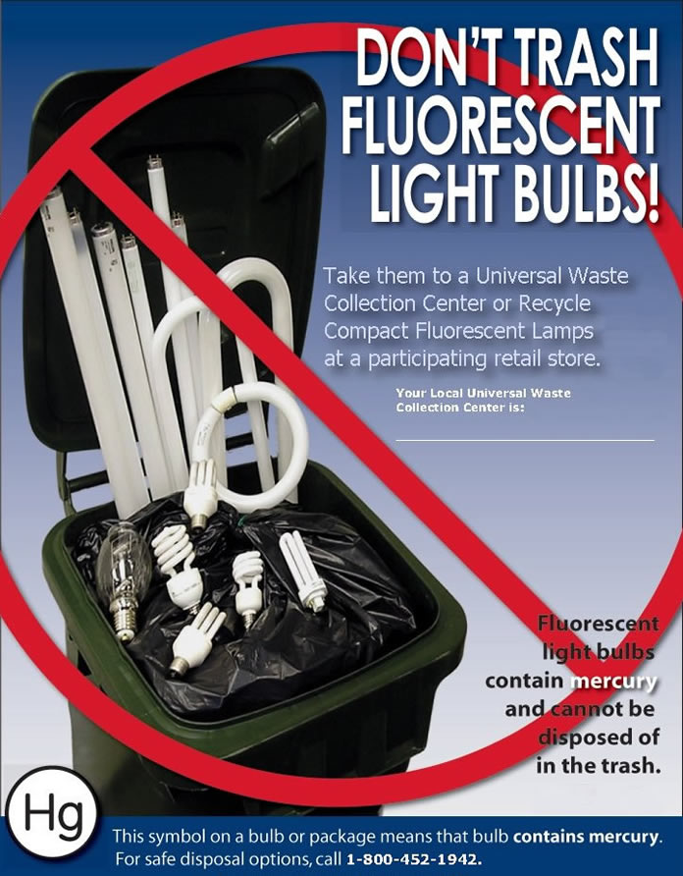
Light Bulbs
Fluorescent bulbs contain Mercury!
Fluorescent bulbs are considered Universal Waste and managed under the Hazardous Waste program
Same day turn-in unless approved by 97 CEIE to store
  Approval by the 97th CEIE to collect UW onsite must be obtained in writing. Facility Manager is responsible for collecting UW for their facility must complete UW training provided by 97 CEIE.
Lamps that use mercury:
  Common fluorescent lamps
  Metal halide lamps
  High pressure sodium lamps used for floodlights
  Streetlights
  Call 481-6198 for pick ups of approved storage containers
FACILITY MANAGERS
Recycling Center
BLDG 400

Slide 15
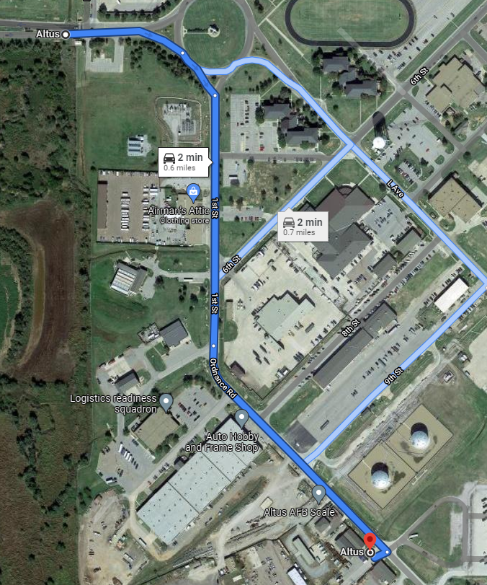
How to get to Recycling Center from Traffic Circle
From Main Gate:
  Head east on Falcon Rd
  At the traffic circle, take the 1st exit – South direction
  Continue onto 1st St .2 mi
  Continue onto Ordnance Rd for .2 mi
  Turn right - You have arrived (Destination will be on the right/Across from big tanks)

Slide 16
OTHER ENVIRONMENTAL TRAINING
Your company should provide specific environmental training relating to your job duties and records are an inspectable item by base environmental and your contracts COR
If you were not provided appropriate environmental training, you can reach out to base environmental POC at the end of this training for guidance

Slide 17
Environmental Training Matrix on eDASH
Environmental Training Matrix | Air Quality Management - Awareness AIR100AFIT00001 | Asbestos Management ASM100AFIT00017 | EMS Practitioner EMS100AFIT00067 | EMS Senior Leader EMS100AFIT00069 | Environmental Compliance Enforcement - Awareness ECE100AFIT00003 | EMS General Awareness Training MyLearning COURSE # MLMW0610 TEACH COURSE # EMS100AFIT00004 | GPP / Sustainable Procurement - Awareness GSP100AFIT00006 | Hazardous Waste Managemnet for IAP Managers | Hazardous Waste Management for Shop Personnel HWM111I0009100091 | Hazardous Materials Management | Tank Custodian STAR | Solid Waste Recycling - Awareness SWR100AFIT00011 | Spill Management SPC100AFIT00020 | Storage Tank Management TKS100AFIT00022 | Air Program Requirements | Storm Water Management - Awareness SWM100AFIT00026 | AFIT Unit Environmental Coordinator Course WENV 220 | Altus AFB SPCC Training | Altus AFB General Environmental Awareness
All PERSONNEL |  |  |  |  |  | X |  |  |  |  |  | X |  |  |  |  |  |  | A
Commanders |  |  |  | X
Facility Mangers |  |  |  |  |  |  |  |  |  |  |  | A |  |  |  | A
Facility Maintenance/Repair Personnel |  | A
GPC Holders & AOs - NAF & AP |  |  |  |  |  |  | X
Shop Hazardous Material Managers/Supervisors |  |  |  |  |  |  |  |  |  | X
Shop Hazardous Waste Handlers/Supervisors |  |  |  |  |  |  |  |  | A
Shop Hazardous Waste IAP Managers/Supervisors |  |  |  |  |  |  |  | X | A
Tank Operators/Custodians |  |  |  |  |  |  |  |  |  |  | X |  | X | X |  |  |  | A
POL Handlers |  |  |  |  |  |  |  |  |  |  |  |  |  |  |  | A |  | A
Pesticide Applicators |  |  |  |  | A |  |  |  |  |  |  | A | A |  |  | A
Unit Environmental Coordinator (UEC) |  |  | X | X |  |  |  |  |  |  |  |  |  |  |  |  | X
EMS CFT Members |  |  | X | X
Air Source Operators | X |  |  |  |  |  |  |  |  |  |  |  |  |  | A
Refer to performing contactors Performance Work Statement (PWS) or Scope of Work (SOW) for specific environmental training requirements.
Minimum environmental training for ALL personnel
Specific training for common job duties/tasks/responsibilities
Required frequency
Applicable references
Training source/database
NOTE: This is only a screenshot of the training matrix and personnel should refer to the Altus Environmental eDASH SharePoint for the most up to date Environmental Training Matrix.
Altus Environmental eDASH SharePoint: https://usaf.dps.mil/teams/10625/Altus/SitePages/Altus%20Environmental%20eDASH%20SharePoint.aspx

Slide 18


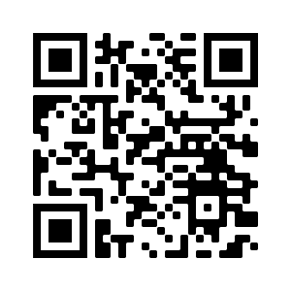
Minimum Environmental Training for ALL Personnel
Environmental Management System - General Awareness Training
Air Force myLearning (CAC ONLY)
The Environmental Awareness Course Hub (TEACH)
VISIT: https://usaf.learningbuilder.com/
Solid Waste Recycling – Awareness
Altus AFB General Environmental Awareness
Scan QR Code to create TEACH account using your work-related email

Slide 19

Liability Risks
Personal Penalties
  Criminal (Jail): Willful violation of the Law
  Civil (Fines)
Organizational Penalties
  Administrative Fines
  $37,500/Violation/Day
  Funding Allocation
  Injunction on Mission

Slide 20

Takeaways!
Comply with Permits, DAFIs, & DAFMANs
  Permits are Laws!
Report Spills & Violations
Communicate with Base Environmental
Implement EMS in the Planning Phase
  Plan, Do, Check, Act
  Reduce Environmental Liability
  Continue Efforts to Promote a Positive Image
    Local Community (≈20K people) AAFB (≈ 6K people)

Slide 21
Questions
Where does Universal Waste need to be taken?
    Landfill
    Environmental Management office
    Recycle Center, Bldg 400
    Your Facility store room
When must Universal Waste, once generated, be taken to the Recycling Center?
    When ever you have a chance
    Same day it is generated
    By the end of the week
    Within 90 days
Notes:
CORRECT ANSWERS:
c. Recycle Center, Bldg 400
b. Same day it is generated

Slide 22
Questions
Which of the following types of batteries can be disposed of in the trash?
a. Lead Acid batteries
b. Any bad batteries
c. Lithium Ion batteries
d. AA batteries
Who authorizes a work center to store Universal Waste?
    a. 97 CEIE, Environmental Element
    b. Squadron Commander
    c. Facility Manager
    d. No authorization required.
Notes:
CORRECT ANSWERS:
d. AA batteries
a. 97 CEIE, Environmental Element

Slide 23
Questions
Which of the following DAFI series covers the EMS requirements?
a. DAFI 32-7065 – Cultural Resources Management
b. DAFMAN 32-1067 – Water and Fuels System
c. DAFI 32-7020 – Environmental Restoration Program
d. DAFI 32-7001 – Environmental Management
Can anything other than clean water enter the storm drain?
    a. No
    b. Yes
Notes:
CORRECT ANSWERS:
d. DAFI 32-7001 – Environmental Management
a. No

Slide 24
Questions
Where do you take large debris? For example a furniture or pallet.
a. Dump them inside dumpster
b. Put them next to dumpster area
c. Leave them in office
d. Take them to Roll Off at Recycling Center, Bldg 400
Which of the listed products is NOT recycled on Altus AFB?
    a. Glass
    b. Cardboard
    c. Paper
    d. Scrap Metal
Notes:
CORRECT ANSWERS:
d. Take the to Roll Off at Recycling Center, Bldg 400
a. Glass

Slide 25
Questions
Does the installation have an Air Permit?
a. No
b. Yes
What material(s) are MANDATORY at Altus AFB by DOD Regulation?
    a. Cardboard and Paper
    Glass and Plastic
    Cardboard and Plastic
    d. Paper and Plastic
Notes:
CORRECT ANSWERS:
b. Yes
a. Cardboard and Paper

Slide 26
Questions
Who in your facility is responsible for the management of spent light bulbs?
a. The Unit Commander
b. The Facility Manager
c. The Section Supervisor
d. The First Sergeant
Notes:
CORRECT ANSWERS:
b. The Facility Manager

Slide 27
Important Environmental Phone #s
Chemical Spills, Discharges, & Releases
  CALL: 911
  Altus AFB Recycling Center
  CALL: 481-7698
  General Environmental Questions
  CALL: 481-5066

Slide 28
Contractors General Environmental Management Awareness Training
After completion of training send your training roster to your Contract Officer Representative (COR) or Contracting Officer within 30 days of employee start date.
CAC holders can find more environmental Information can be found on the Altus Environmental eDASH SharePoint: https://usaf.dps.mil/teams/10625/Altus/SitePages/Altus%20Environmental%20eDASH%20SharePoint.aspx
Base Environmental Contact Information
DSN: 866-5066
Commercial: 580-481-5066
Email: 97ces.ceie.qa@us.af.mil

