Slide 1
Altus AFB General Environmental Management Awareness Training Updated FEB 2025
OPR: 97 CES/CEIE
97 CES Environmental

Slide 2
Course Content
Description
This course provides essential information on environmental requirements for personnel under the Altus AFB EMS, intended to supplement the REQUIRED Air Force EMS General Awareness Training available on myLearning and TEACH.
Objective
Upon completion, participants will understand the environmental requirements for Altus AFB employees to align with the 97 AMW/CC Environmental Vision/Commitment Statement.

Slide 3
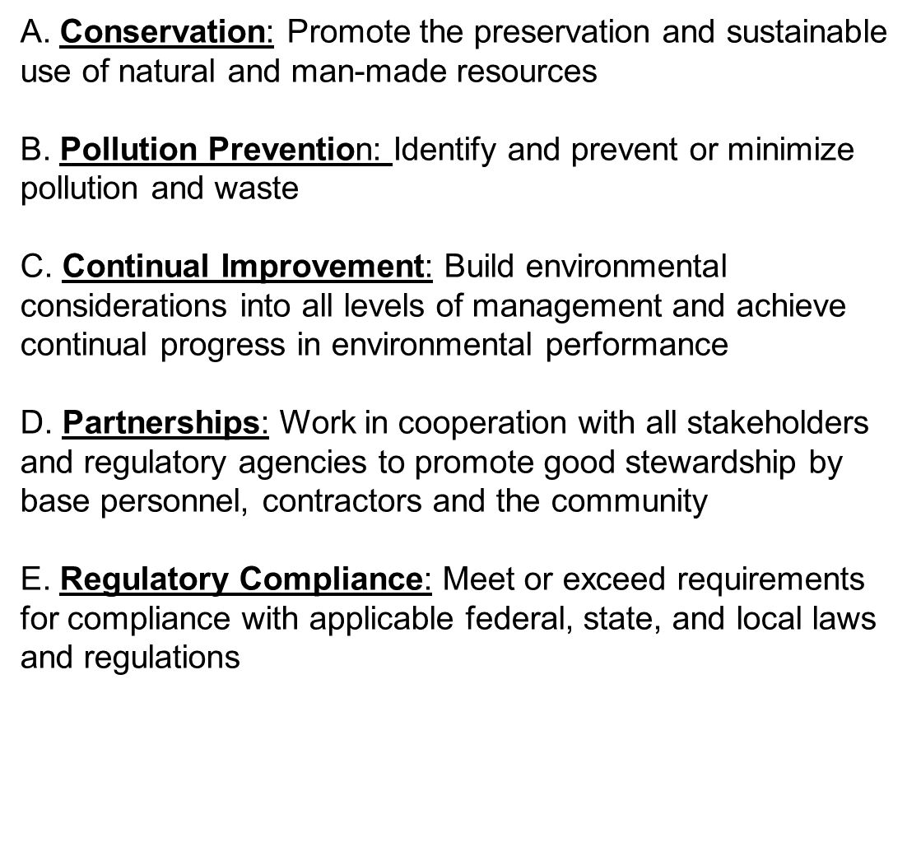
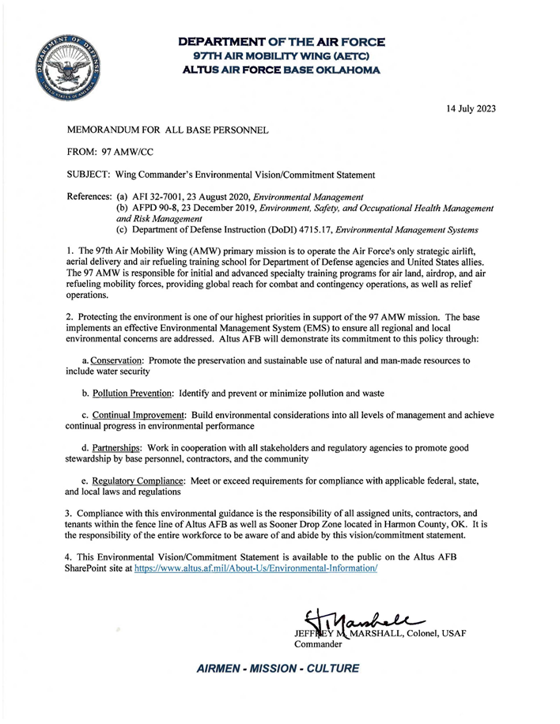
Wing Commander’s Environmental Vision/Commitment Statement

Slide 4
AAFB ENVIRONMENTAL PLANS
Standard Title | R/O | Installation Specific Title | Signatory | Requiring Agency Level | Regulatory Driver/Media | Requiring Agency | Citation | Regulatory Frequency
Integrated Cultural Resources Management Plan (ICRMP) | AF/DOD | ICRMP | AMW/CC | AF/DOD | DODI 4715.16; DAFMAN 32-7003 | SHPO | DoDI 4715.3; AFI 32-7065; ADPD 32-70 | 5 Years
Installation Tribal Relations Plan (ITRP) | AF/DOD | ITRP | AMW/CC | AF/DOD | DAFI90-2002 | Air Force | DoDI 4710.02; AFPD 90-20; AFPD 32-70 (Supporting plan to ICRMP) | 5 Years
Facility Response Plan (FRP) | Regulatory | Altus AFB Facility Response Plan | AMW/CC | Federal | CWA-OPA | US EPA | 40 CFR 112.20 | 5 Years
Hazardous Waste Management Plan (HWMP) | AF/DOD | Hazardous Waste/Recovery Waste Management Plan (32-J1) |  | AF/DOD | DoDI4715.06; DAFMAN32-7002 | Air Force | AFI 32-7042 3.2 | 1 Year
Integrated Solid Waste Management Plan (ISWMP) | AF/DOD | ISWMP |  | AF/DOD | RCRA-D; DoDI4715.06; DoDI4715.23 DAFMAN32-7002 | Air Force | AFI 32-7042, para 3.2.2. | 1 Year
Integrated Natural Resources Management Plan (INRMP) | Regulatory | INRMP | AMW/CC | Federal | DAFMAN32-7003 | Congress | Sikes Act (16 U.S.C. 670) | 5 Years
Wildland Fire Management Plan (WFMP) | AF/DOD | WFMP | AMW/CC | Federal | DAFMAN32-7003 | AFCEC/CZOF | AFI 32-2001 Supporting plan to INRMP | 5 Years
Prescribed Burn Plan (PFP) | AF/DOD | PFP | AMW/CC | Federal | DAFMAN32-7003 | AFCEC/CZOF | Supporting plan to INRMP | 5 Years
Asbestos Management Plan | Regulatory | Asbestos Management and Operations Plan | CES/CC | Federal | Other | Air Force | AFI 32-1052 | As Needed
Stormwater Pollution Prevention Plan (Industrial) | Regulatory | Altus AFB Storm Water Pollution Prevention Plan |  | Federal | CWA | Oklahoma Dept. of Environmental Quality | OAC 252:606-1-3(b)(3)(L) | As Needed
Spill Prevention, Control, and Countermeasures Plan (SPCC) | Regulatory | Final Spill Prevention Control and Countermeasures Plan | AMW/CC | Federal | CWA-OPA | EPA Region 6 | 40 CFR 112 | 5 Years
Five Year Review | Non-Compliance Tracking | 957824045-CA |  | CZO | CERCLA, NCP | Oklahoma DEQ | 40 CFR 264 Subpart F | 3 Years

Slide 5
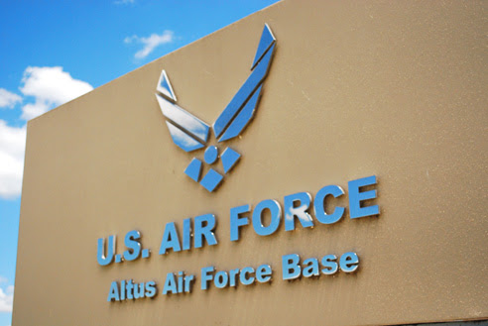
Altus AFB Environmental Risk/Aspect
Altus AFB Environmental Programs with Risks and Costs
Hazardous Materials
Air Quality
Wastewater
Natural Resources
Fuels; Tanks; Petroleum, Oils, & Lubricants
Hazardous Waste
Environmental Impact Analysis Process
Drinking Water
Storm Water
Solid Waste
Environmental Noise
Cultural Resources
Toxic Materials (Asbestos, Lead-based Paint [LBP], Polychlorinated Biphenyl [PCB] )
Green Procurement
Pest Management
Recycling

Slide 6
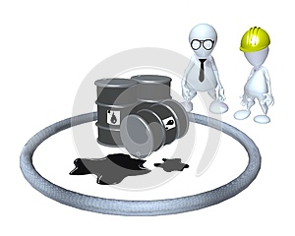
Spill Reporting
Spills, Discharges, & Releases
Hazardous Material/Waste
Water/Sewage/Industrial Wastewater
Oil/Lubricants
Fuel
Contact/Report Immediately:
For any spill, discharge, or releases
Nothing other than clean water can enter a storm drain
Link to spill report form:
https://usaf.dps.mil/:w:/r/teams/10625/Altus/_layouts/15/Doc.aspx?sourcedoc=%7BC05ADD67-4AF1-4022-9C15-50E10264D63A%7D&file=Altus%20AFB%20Spill%20Report%20Form%202021.docx&action=default&mobileredirect=true
Call
911
Emergency number from your cell phone:
580-481-6333 (Fire Dept)

Slide 7
Recycling Center Building 400
Recycle Center # 580-481-7698
White & Mixed Paper/
Cardboard
MANDATORY per DODI
Shedded paper MUST be bagged
#1 & #2 Plastic
Ensure containers are empty & MUST be Bagged
No liquids: tobacco, soda remnants, etc.
Steel & Aluminum Cans – NO liquids: tobacco. Soda remnants, etc.
Building 400
Scrap Metals/
Copper Wire
*Lithium Ion
*Nickel-Cadmium (NiCad)
*Nickel Metal Hydride
RECYCLED: Lead Acid
Lithium Ion and NiCad are considered Universal Waste
*** 90-day turn-in timeframe to building 400 ***

Slide 8
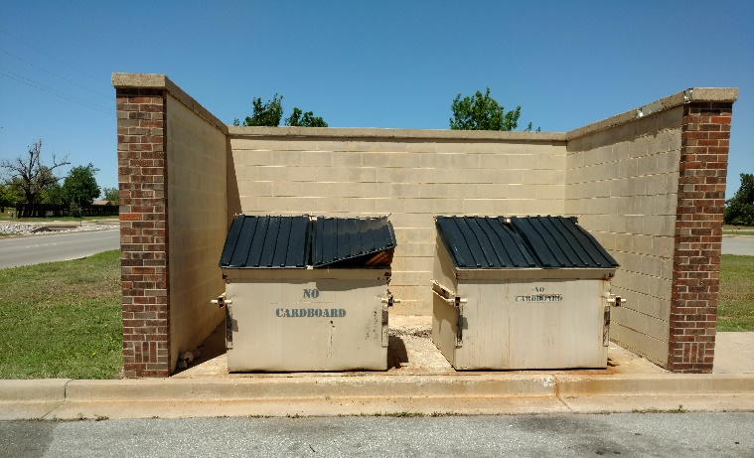
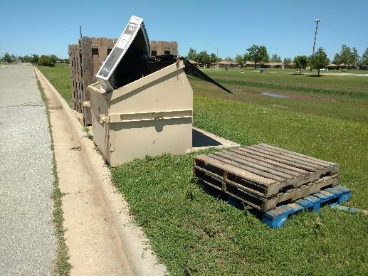
Community Dumpsters – Do YOUR part!
The area around the dumpsters MUST remain free of trash or items that may interfere with the placement of the dumpster
VIOLATIONS prevent the dumpster from being emptied.
Ex. Items sticking out of dumpsters. Pieces of wood must not be stored inside. This can damage equipment!

Slide 9
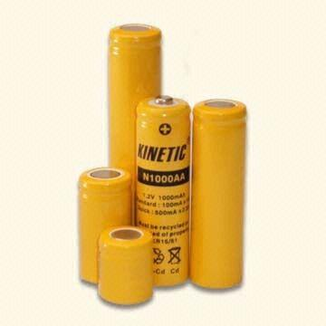
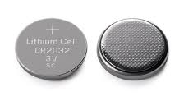
Which batteries can go in the trash?
C
A
B
D
A. AA, AAA, C, D & 9V batteries can go into the trash
Universal waste must be turned in to building 400 same day unless approved by 97 CEIE to store.
B. NiCad are batteries and must be managed as Universal Waste
C. Lithium batteries are Universal Waste
D. Nickel Metal Hydride (NiMH) are Universal Waste

Slide 10
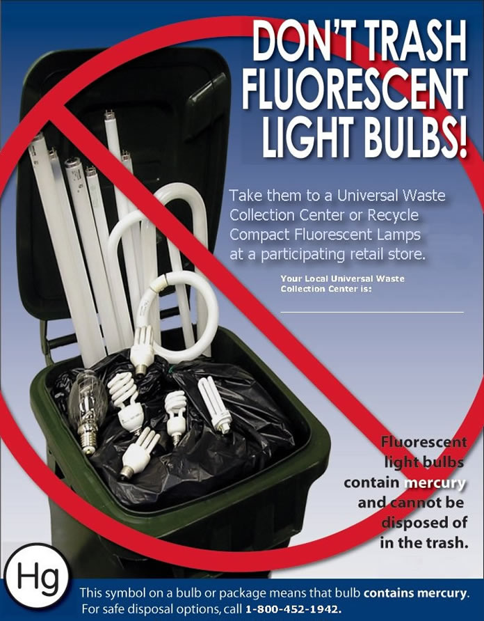
Light Bulbs
Fluorescent bulbs contain Mercury!
Fluorescent bulbs are considered Universal Waste and managed under the Hazardous Waste program
Same day turn-in unless approved by 97 CEIE to store
Approval by the 97th CEIE to collect UW onsite must be obtained in writing. Facility Manager is responsible for collecting UW for their facility must complete UW training provided by 97 CEIE.
Lamps that use mercury:
Common fluorescent lamps
Metal halide lamps
High pressure sodium lamps used for floodlights
Streetlights
Call 481-6198 for pick ups of approved storage containers
FACILITY MANAGERS
Recycling Center
BLDG 400

Slide 11
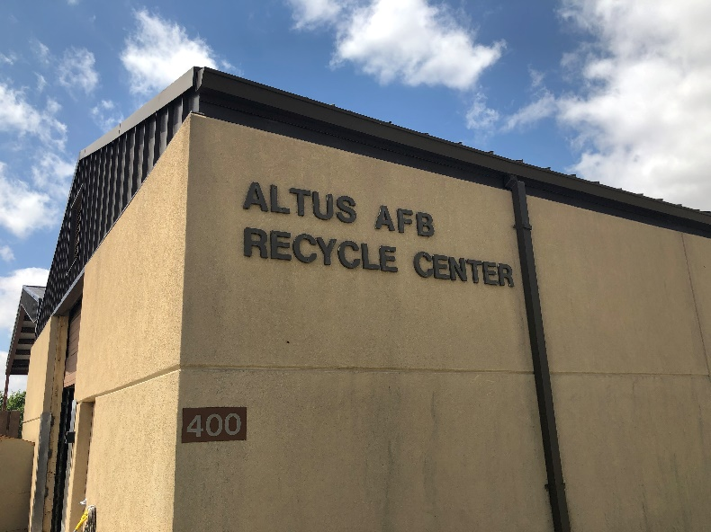
What CAN be recycled at the Recycling Center?
YES
NO
Aluminum / Tin Cans
Plastics (# 1 & # 2) (bagged)
Mixed Paper / Magazines / Newspaper
Cardboard
Scrap Metal
Light Bulbs
Pallets
Lead Acid Batteries
Rechargeable Batteries
Shredded Paper (Must Be BAGGED)
Laser/Ink Jet Printer Cartridges
Tires
Wood
Construction debris
Glass
Oil (Auto Hobby Shop can take
used oil)
Paint (contact HW PM)
Clothing (Airman’s Attic)
Furniture (Airman’s Attic)
Questions??
Call 471-6436 or 481-6221

Slide 12
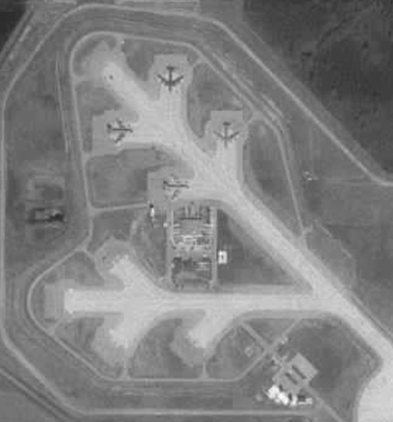
Environmental Insights: Altus AFB Overview
Personnel
2,987 Military/Dependents
1,221 Civilian Personnel
6,000 acres of land
26.15 acres of Wetland
1 Historic bldg. (285) and 1 structure National
Registry (Alert Apron) eligible
2 native prairie restoration sites in progress
29 Restoration sites
1492 tons/yr - Solid Waste – 59% recycled
158 Air sources
4M gal fuel stored; 82 ASTs
24 tons/yr Regulated waste generated
26K containers of HazMat managed annually
“Scissor-Tailed Flycatcher”
“Alert Apron
AKA ‘The Christmas Tree’”
“Indian Blanket”
“Oklahoma Rose”

Slide 13
Minimum Environmental Training for ALL Personnel
The Environmental Awareness Course Hub (TEACH)
Air Force myLearning (CAC ONLY)
VISIT: https://usaf.learningbuilder.com/
Environmental Management System - General Awareness Training
Course # EMS100AFIT00004
REQUIRED one time training!
Approximate completion time: 10 minutes.

Slide 14
Environmental Training Matrix on eDASH
Environmental Training Matrix | Air Quality Management - Awareness AIR100AFIT00001 | Asbestos Management ASM100AFIT00017 | EMS Practitioner EMS100AFIT00067 | EMS Senior Leader EMS100AFIT00069 | Environmental Compliance Enforcement - Awareness ECE100AFIT00003 | EMS General Awareness Training MyLearning COURSE # MLMW0610 TEACH COURSE # EMS100AFIT00004 | GPP / Sustainable Procurement - Awareness GSP100AFIT00006 | Hazardous Waste Managemnet for IAP Managers | Hazardous Waste Management for Shop Personnel HWM111I0009100091 | Hazardous Materials Management | Tank Custodian STAR | Solid Waste Recycling - Awareness SWR100AFIT00011 | Spill Management SPC100AFIT00020 | Storage Tank Management TKS100AFIT00022 | Air Program Requirements | Storm Water Management - Awareness SWM100AFIT00026 | AFIT Unit Environmental Coordinator Course WENV 220 | Altus AFB SPCC Training | Altus AFB General Environmental Awareness
All PERSONNEL |  |  |  |  |  | X |  |  |  |  |  |  |  |  |  |  |  |  | A
Commanders |  |  |  | X
Facility Mangers |  |  |  |  |  |  |  |  |  |  |  | A |  |  |  | A
Facility Maintenance/Repair Personnel |  | A
GPC Holders & AOs - NAF & AP |  |  |  |  |  |  | X
Shop Hazardous Material Managers/Supervisors |  |  |  |  |  |  |  |  |  | X
Shop Hazardous Waste Handlers/Supervisors |  |  |  |  |  |  |  |  | A
Shop Hazardous Waste IAP Managers/Supervisors |  |  |  |  |  |  |  | X | A
Tank Operators/Custodians |  |  |  |  |  |  |  |  |  |  | X |  | X | X |  |  |  | A
POL Handlers |  |  |  |  |  |  |  |  |  |  |  |  |  |  |  | A |  | A
Pesticide Applicators |  |  |  |  | A |  |  |  |  |  |  | A | A |  |  | A
Unit Environmental Coordinator (UEC) |  |  | X | X |  |  |  |  |  |  |  |  |  |  |  |  | X
EMS CFT Members |  |  | X | X
Air Source Operators | X |  |  |  |  |  |  |  |  |  |  |  |  |  | A
Refer to performing contactors Performance Work Statement (PWS) or Scope of Work (SOW) for specific environmental training requirements.
Minimum environmental training for ALL personnel
Specific training for common job duties/tasks/responsibilities
Required frequency
Applicable references
Training source/database
NOTE: This is only a screenshot of the training matrix and personnel should refer to the Altus Environmental eDASH SharePoint for the most up to date Environmental Training Matrix.
Altus Environmental eDASH SharePoint: https://usaf.dps.mil/teams/10625/Altus/SitePages/Altus%20Environmental%20eDASH%20SharePoint.aspx

Slide 15
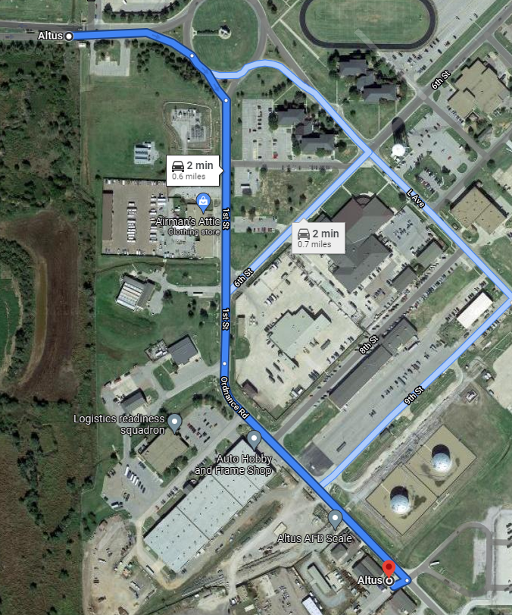
How to get to Recycling Center from Traffic Circle
From Main Gate:
Head east on Falcon Rd
At the traffic circle, take the 1st exit – South direction
Continue onto 1st St .2 mi
Continue onto Ordnance Rd for .2 mi
Turn right - You have arrived (Destination will be on the right/Across from big tanks)

Slide 16
Takeaways!
Comply with Permits, DAFIs, & DAFMANs
Permits are Laws!
Report Spills & Violations
Recycle!
Communicate with Base Environmental
Implement EMS in the Planning Phase
Plan, Do, Check, Act
Reduce Environmental Liability
Promote a Positive Image
Complete EMS General Environmental Awareness

Slide 17
Questions
Where does Universal Waste need to be taken?
Landfill
Environmental Management office
Recycle Center, Bldg 400
Your Facility store room
When must Universal Waste, once generated, be taken to the Recycling Center?
When ever you have a chance
Same day it is generated
By the end of the week
Within 90 days
Notes:
CORRECT ANSWERS:
c. Recycle Center, Bldg 400
b. Same day it is generated

Slide 18
Questions
Which of the following types of batteries can be disposed of in the trash?
a. Lead Acid batteries
b. Any bad batteries
c. Lithium Ion batteries
d. AA batteries
Who authorizes a work center to store Universal Waste?
a. 97 CEIE, Environmental Element
b. Squadron Commander
c. Facility Manager
d. No authorization required.
Notes:
CORRECT ANSWERS:
d. AA batteries
a. 97 CEIE, Environmental Element

Slide 19
Questions
Who in your facility is responsible for the
management of spent light bulbs?
a. The Unit Commander
b. The Facility Manager
c. The Section Supervisor
d. The First Sergeant
Can anything other than clean water enter the storm drain?
a. No
b. Yes
Notes:
CORRECT ANSWERS:
d. DAFI 32-7001 – Environmental Management
a. No

Slide 20
Questions
Where do you take large debris? For example, a furniture.
a. Dump them inside dumpster
b. Put them next to dumpster area
c. Leave them in office
d. Roll Off at Recycling Center, Bldg 400
Which of the listed products is NOT recycled on Altus AFB?
a. Glass
b. Cardboard
c. Paper
d. Scrap Metal
Notes:
CORRECT ANSWERS:
d. Take the to Roll Off at Recycling Center, Bldg 400
a. Glass

Slide 21
Questions
Does the installation have an Air Permit?
a. No
b. Yes
What material(s) are MANDATORY at Altus AFB by DOD Regulation?
a. Cardboard and Paper
Glass and Plastic
Cardboard and Plastic
d. Paper and Plastic
Notes:
CORRECT ANSWERS:
b. Yes
a. Cardboard and Paper

Slide 22
Important Environmental Phone #s
Chemical Spills, Discharges, & Releases
CALL: 911
Altus AFB Recycling Center
CALL: 481-7698
General Environmental Questions
CALL: 481-7605

