Slide 1
Comptroller Services Portal Finance Customer Service
97th Comptroller Squadron

Slide 2
Overview
CSP Introduction
Quick Start Guide
Knowledge Articles
Inquiry Creation & Submission
Troubleshooting
Non-AFNET user assistance
Profile Creation for non-AFNET (@us.af.mil)
Forwarding AFNET email to non-AFNET

Slide 3
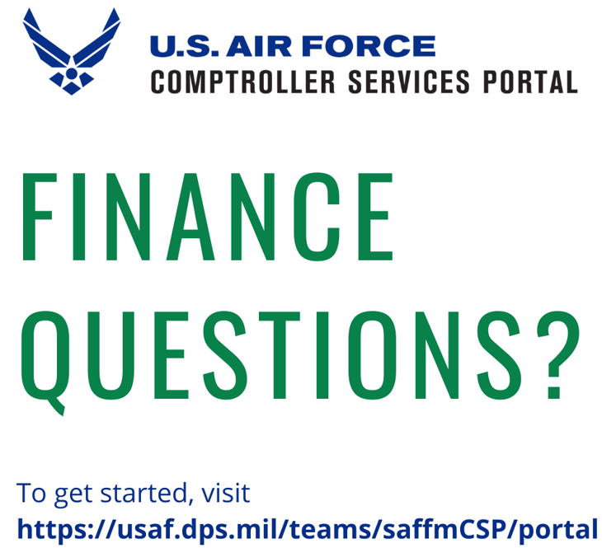
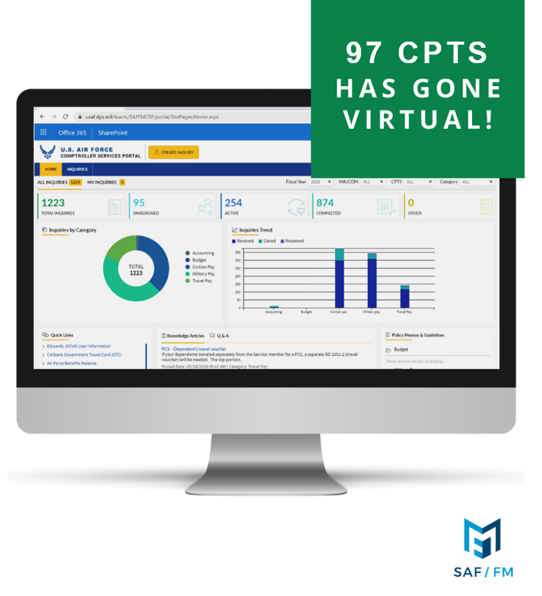
412 CPTS
CAC required with AFNET (@us.af.mil) presence
Use MS Edge or Google Chrome
Clickable Link: https://usaf.dps.mil/teams/saffmCSP/portal/

Slide 4
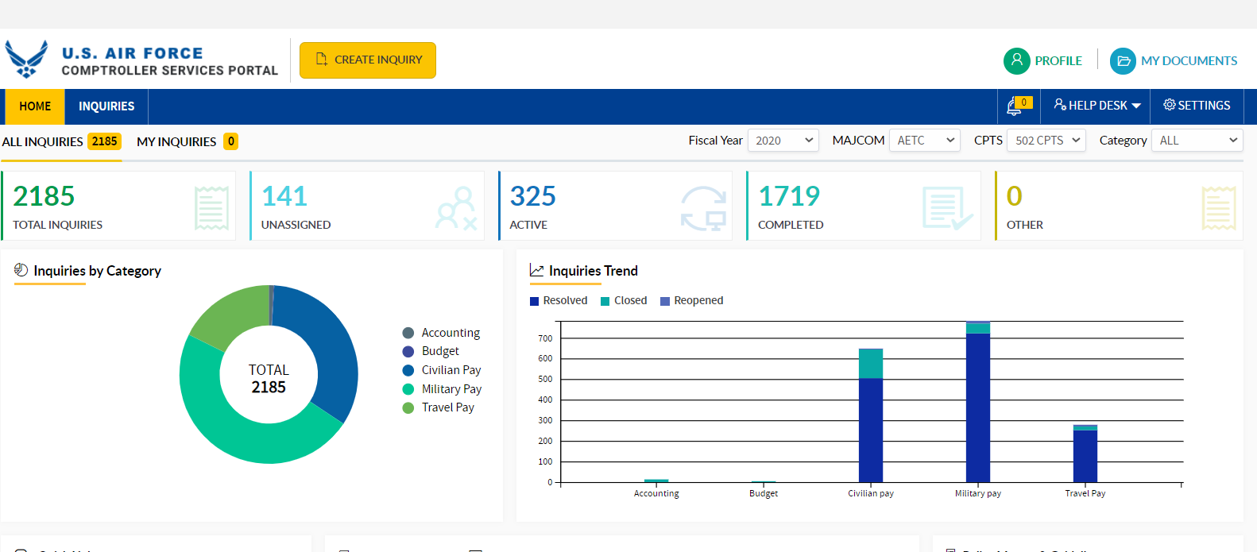
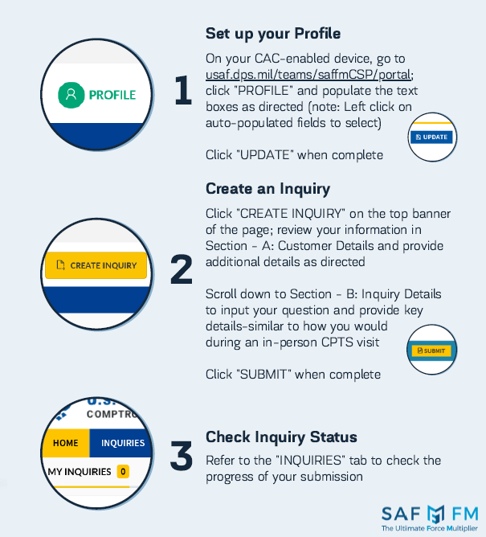
Quick Start Guide

Slide 5
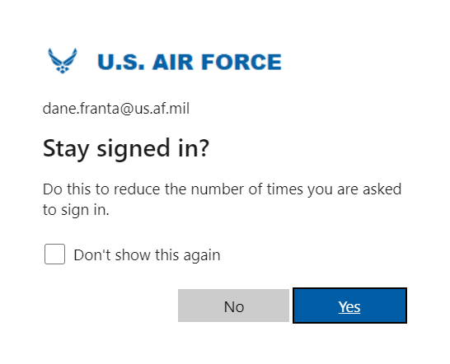
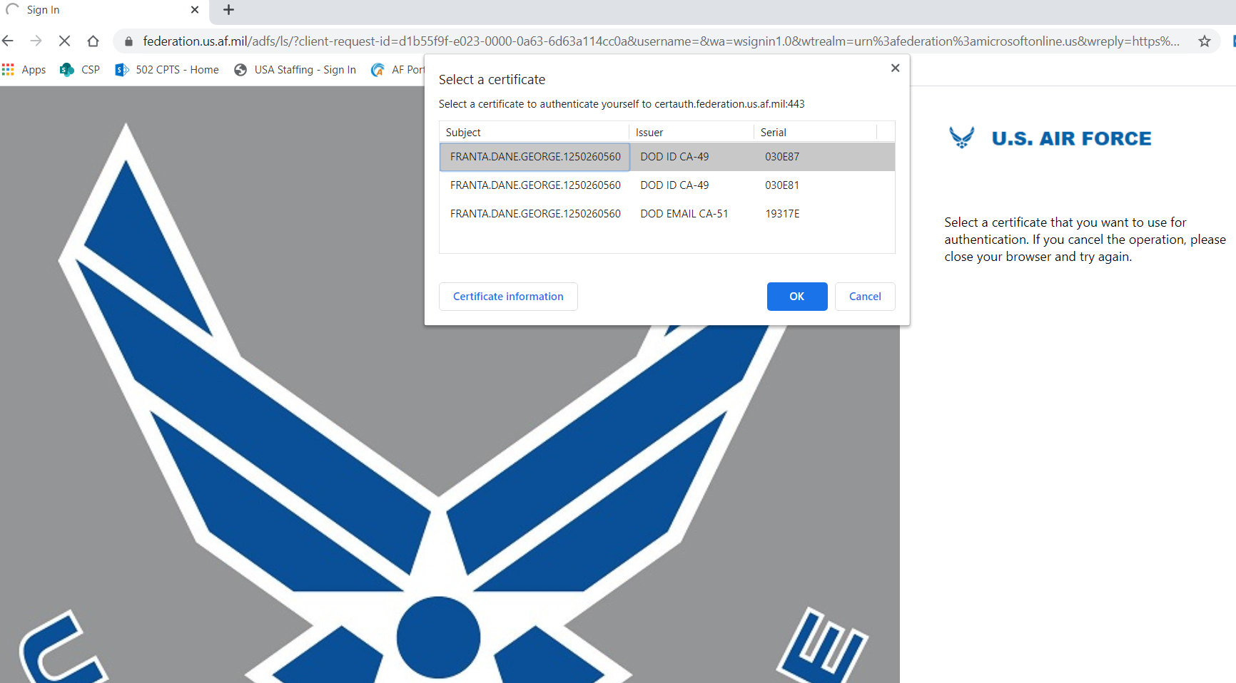
Initial Log-on
If you’re not plugged into AF Network, you’ll likely find this screen to log-in to AFNET’s MS Office 365 first.
Use your Authentication certificate
Page updates, dialog box appears, click YES
You’ll be taken to CSP homepage
1
2
3
4

Slide 6
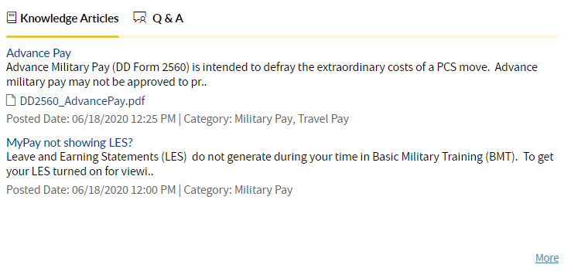
Knowledge Articles
Save time by reading topics to find forms or answer questions without or before submitting an inquiry
Middle of main page, expand to all topics by clicking “More”
Key word searchable; just start typing
Many have template forms to speed your inquiry processing, check for attached docs!
1
2
3

Slide 7
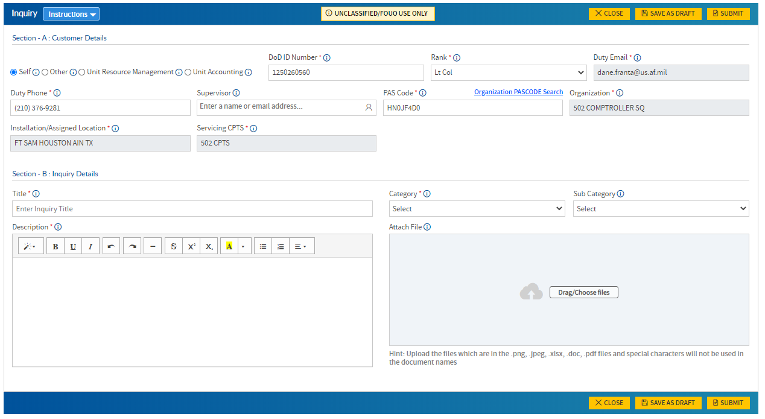
Inquiry Creation – Send us your questions!
1
From main page:
Click “Create Inquiry”
Form dialogue box opens
Verify your user info
Title, Select Category & Provide details
Upload pertinent documents
Submit inquiry
2
a
Need more help? Click Instructions button
b
Keep Title short & focused
Review Categories for best fit
If Subcategory doesn’t fit well, try another Category (Travel Pay instead of Mil Pay)
c
3

Slide 8
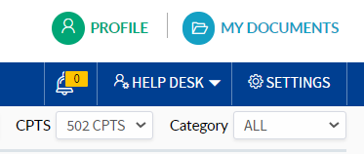
Inquiry Submission Lessons Learned & Quick Tips
Personal pay, timecards, or travel orders?
Make sure to select Category as “Military Pay,” “Civilian Pay,” or “Travel Pay”
“Travel Pay” is for most PCS actions (Military or Civilian members)
“Accounting” is for Unit Resource Advisors & CPTS/FMA
Check for notification updates from CPTS
CSP does not send auto-email when we post a comment
We may need something from you
Improve submissions by reading Knowledge Articles
Upload/Attach proper forms to get to action faster
Status updates?
Don’t send in another, new inquiry; just add a note in Discussions area of the specific inquiry
Saves you from starting the conversation over
If inquiry was resolved…just re-open it, post your question in Discussion and re-submit
PCS In-processing Appointments?
Schedule an appointment for in-person in-processing
https://www.signupgenius.com/go/904044aa8a629a2f94-pcsinprocessing
Retire/Sep/PCS Out-processing?
Send an inquiry with subject line “Out-process Final Out DD/MM”
Retire/Sep checklist is loaded in Knowledge Articles
PCS Out-processing – Upload signed orders (front & back) with date of final out
2

Slide 9
Troubleshooting
Key Lessons Learned:
Using right browser (MS Edge or Google Chrome)?
Signed in with Authentication certificate (do not use email cert)?
Non-AFNET network users – Try without logging into VPN/network hardwire; try using only Wi-Fi & CAC
Clear browser cache
Close all instances of browser application(s)
Re-authenticate to site (logout, clear cache, close browser, re-access)
No luck with the above actions?
Take a screen shot of problem/browser page
Copy URL address from address bar
Send email with #1 & #2 to: 2Lt Jared Tao

Slide 10
Notes Particular to DHA network users
Does not apply to AFNET users (@us.af.mil accounts)

Slide 11
Notes for Non-AFNET users
We’re still working through bringing CSP to non-AFNET users, most prevalently with DHA users
DHA users can access provided they have an AFNET presence (@us.af.mil)
Must be off-network hard line (i.e. On Wi-Fi, or at home with CAC reader & NOT on VPN)
Must establish & communicate with AFNET presence
Following slides depict how to evaluate if you can access & how to forward AFNET email to another network
e.g. @mail.mil

Slide 12
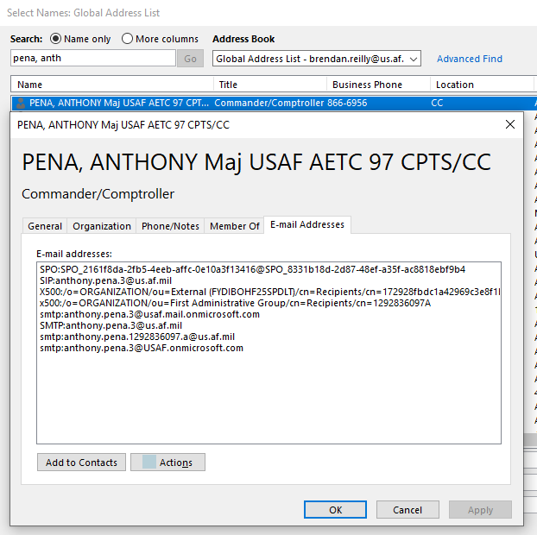
Setting up your Profile Verifying AFNET Presence
Look yourself up in GAL
Click “E-mail Addresses” tab
Verify you have an email that ends with @us.af.mil
Annotate your DOD ID#
Also on back of CAC
Use these elements to update your CSP profile
Currently CSP will only take @us.af.mil email addresses in member profiles
1
2
3
4

Slide 13
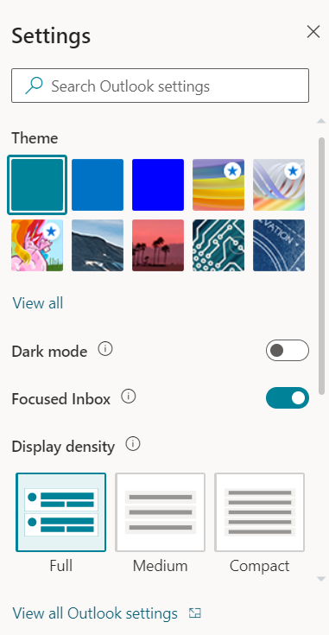
Setting up your email Only for those Not on AFNET, but have AFNET email
You can still use CSP & get notices sent to you by forwarding your AFNET email to another (ex: @mail.mil) by setting a rule for AFNET email to auto-forward
2
Access AFNET webmail
https://webmail.apps.mil/mail/owa/us.af.mil
Top right corner – Click “Settings” gear icon
Window opens
At bottom of new window, Click “View all Outlook Settings”
Establish a rule to forward AFNET email to another email
3

Slide 14
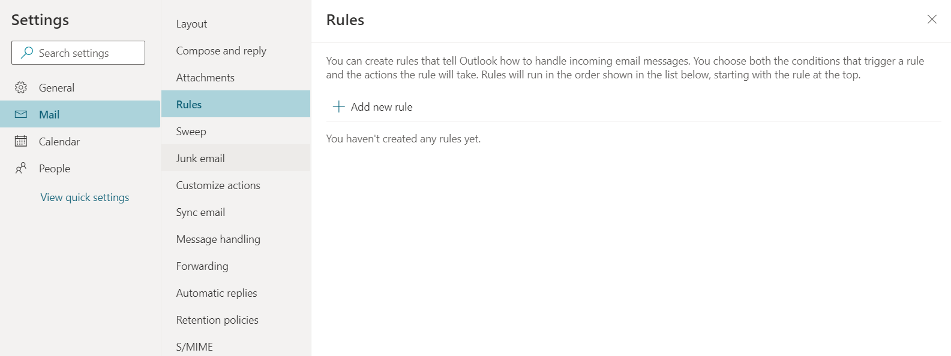
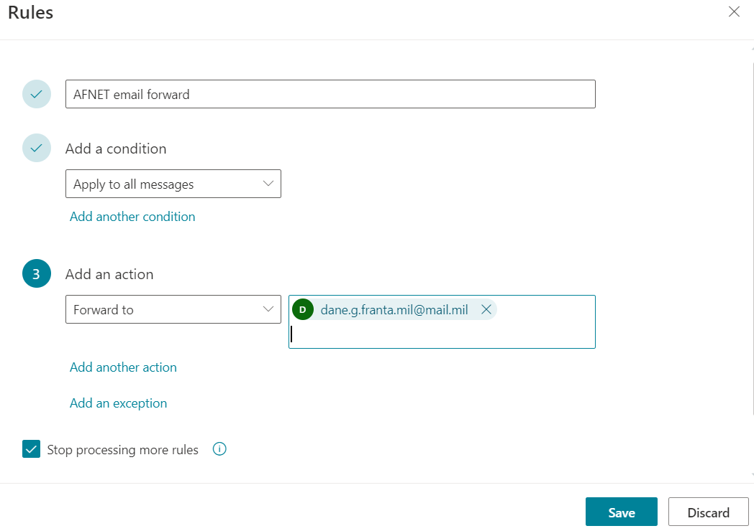
Setting up your email Only for those Not on AFNET, but have AFNET email
Continued
4
Establish a rule to forward AFNET email to another email address
Fill in boxes
Click Save
Close webmail
Depending on email size & network load there can sometimes be a delay in AFNET to non-AFNET email forwarding
5
6

