Slide 1
Contractors General Environmental Management System (EMS) Awareness
97 CES/CEIE
Environmental Element
4 September 2025
Updated: SEPT 2025

Slide 2
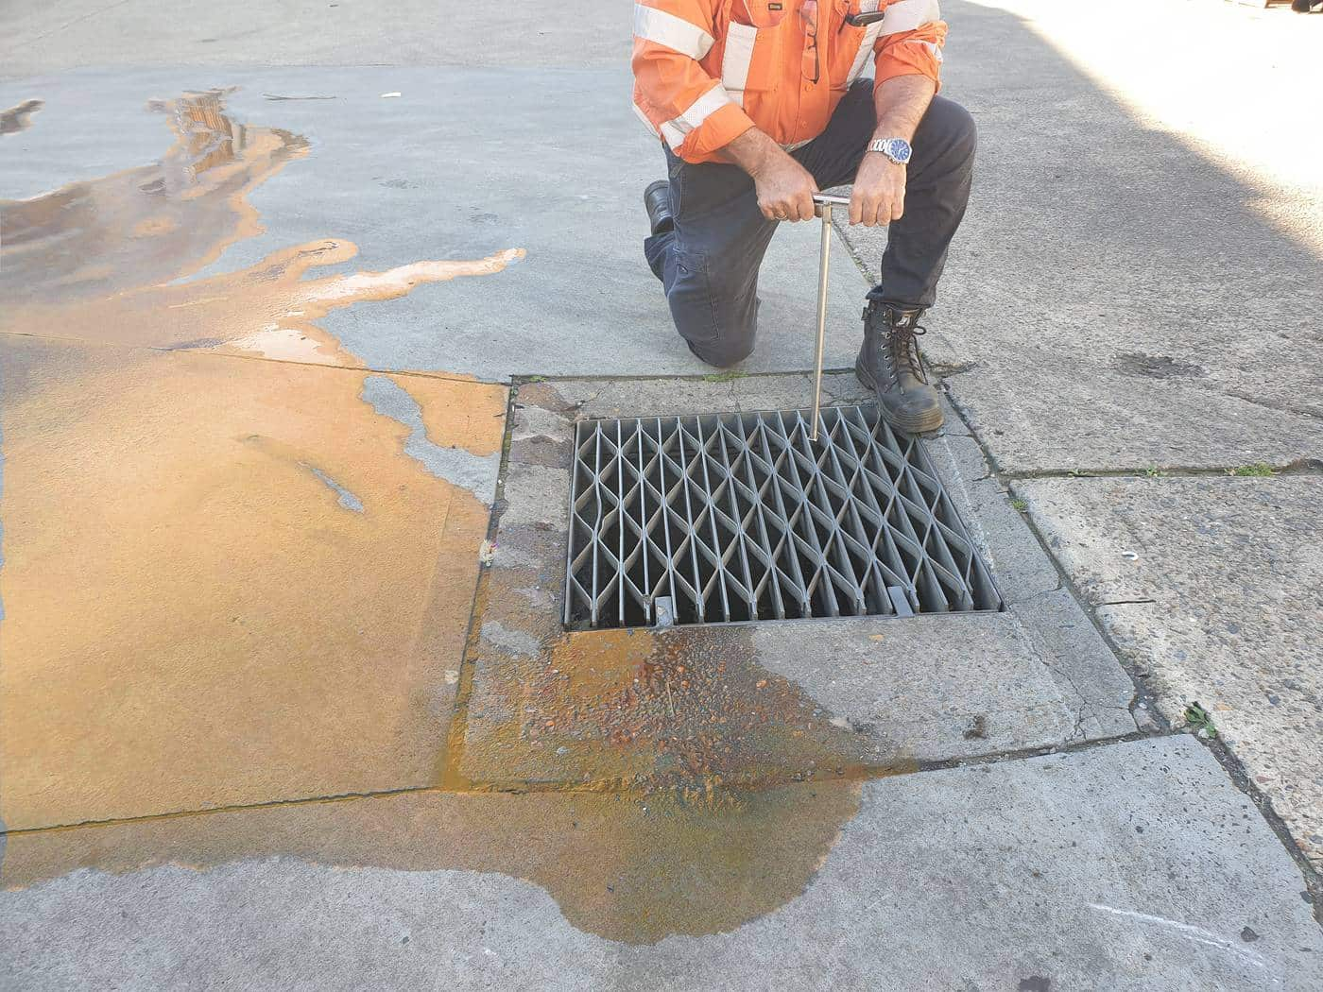
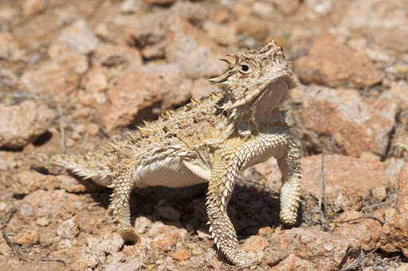
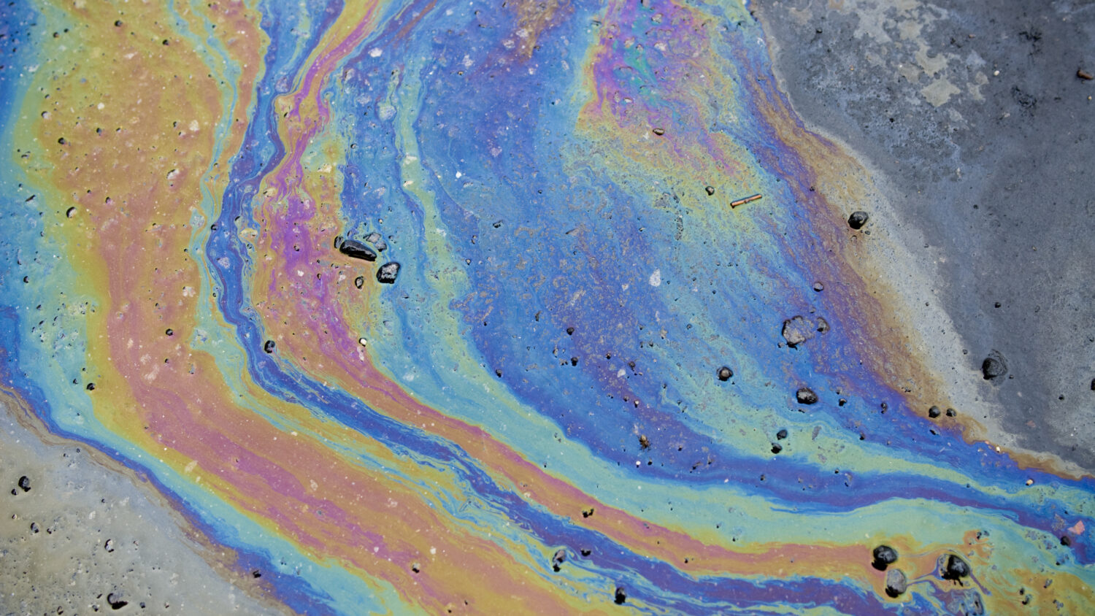

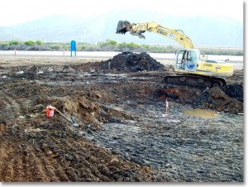
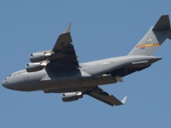
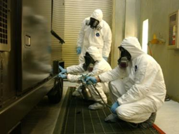
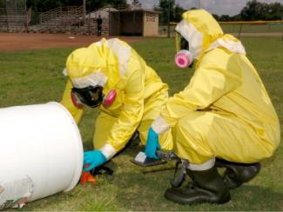
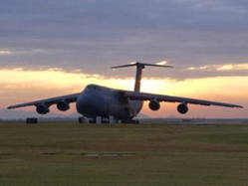
Contractor EMS Awareness
Environmental Vision/Commitment
Significant Environmental Aspects
Awareness
Attributes
Spill Reporting
Solid Waste
Questions
Conclusion
Contacts
References

Slide 3
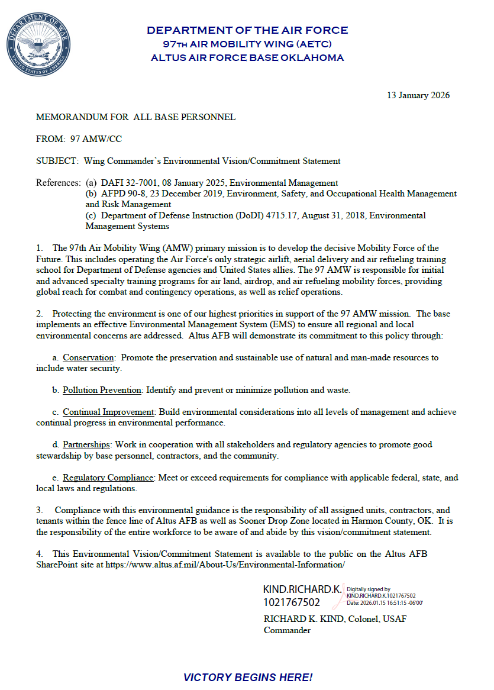
Wing Commander’s Environmental Vision
A. Conservation: Promote the preservation and sustainable use of natural and man-made resources to include water security.
B. Pollution Prevention: Identify and prevent or minimize pollution and waste C. Continual Improvement: Build environmental considerations into all levels of management and achieve continual progress in environmental performance D. Partnerships: Work in cooperation with all stakeholders and regulatory agencies to promote good stewardship by base personnel, contractors and the community E. Regulatory Compliance: Meet or exceed requirements for compliance with applicable federal, state, and local laws and regulations

Slide 4
Significant Aspects & Your Role
Embrace the Base Environmental Ethos: Understand & support the Altus AFB Environmental Statement.
Master Your Contract's Green Mandates: Know & fulfill all environmental requirements within your contract.
Minimize Your Impact: Identify & proactively manage the environmental effects of your work.
Employ Best Practices: Implement BMPs (Best Management Practices) consistently for all activities.
Report Spills IMMEDIATELY: Contact Altus AFB Emergency Services for any spill or release.
Train for Environmental Excellence: Ensure all personnel are fully trained on their environmental responsibilities.
Maintain Strict Compliance: Adhere rigorously to all applicable regulations & instructions.
Prepare for the Unexpected: Know emergency contacts & procedures for swift, effective response

Slide 5
Be Aware!
Power Down: Turn off lights, monitors, & other electrical equipment when not in use.
Report Leaks Promptly: Notify the facility manager of any water leaks or waste.
Recycle Responsibly: Maximize the use of recycling bins for appropriate materials.
Never Dump Chemicals: Do NOT pour chemicals down drains.
Proper Chemical Management: Ensure all chemicals are authorized before bringing them on base, & handle, store, and dispose of them correctly.
Maintain Silt Fences: During construction, ensure silt fences are properly maintained to prevent erosion.
No Debris Around Dumpsters: Dispose of waste properly; keep dumpster areas clean.
Dispose of Waste Correctly: Dispose of batteries and fluorescent bulbs through designated channels (not in regular trash).
Be Environmentally Aware: Observe work zones for potential environmental issues & report them immediately.

Slide 6
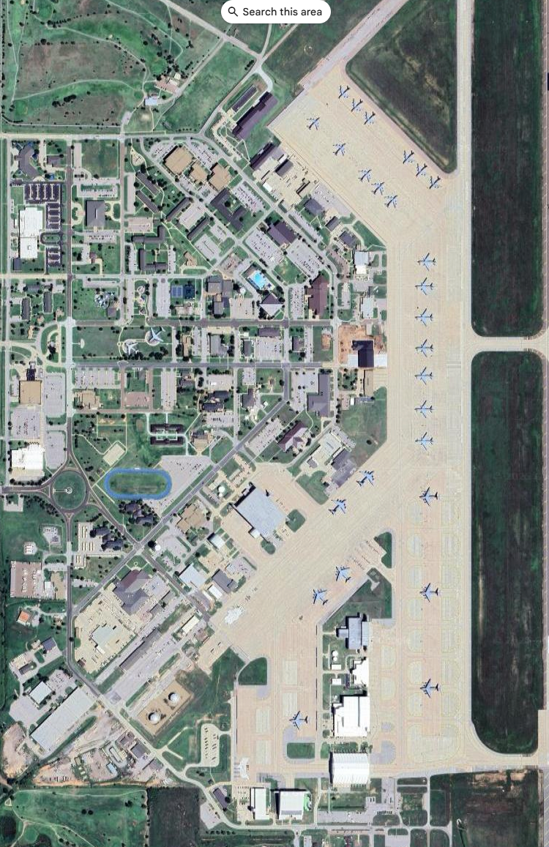
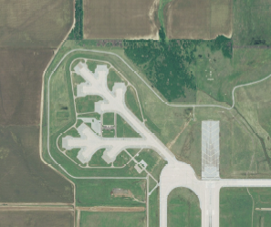
Altus AFB Environmental Attributes
8,016 acres of land
15.47 acres of Wetland
29 Restoration sites
Land use controls (restricted digging)
537 tons/yr - Solid Waste – 51% recycled
Personnel
2,583 Military/Dependents
1,811 Civilians
1,012 Retirees
0 Historic bldgs. and 1 National Registry eligible structure.
158 Air sources
4M gal fuel stored; 82 ASTs
24 tons/yr Regulated waste generated
26K containers of HazMat managed annually
Alert Apron
Altus Air Force Base

Slide 7

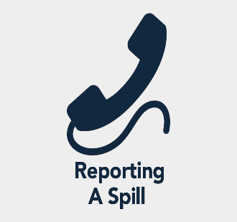
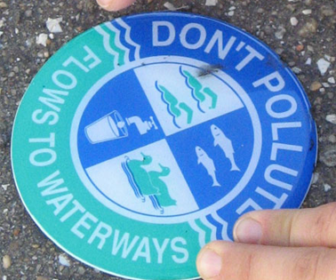
Spill Reporting
Spills, Discharges, Releases
Hazardous Waste
Water/Sewage/Industrial Wastewater
Oil/Lubricants
Fuel
Emergency number from your cell phone:
580-481-6333 (Fire Dept)
Contact/Report Immediately:
For any spill, discharge, or releases that:
Occur outside
Enters a storm/sanitary drain
Reaches soil
Nothing other than clean water can enter a storm drain
Call
911
Link to spill report form:
https://usaf.dps.mil/:w:/r/teams/10625/Altus/_layouts/15/Doc.aspx?sourcedoc=%7BC05ADD67-4AF1-4022-9C15-50E10264D63A%7D&file=Altus%20AFB%20Spill%20Report%20Form%202021.docx&action=default&mobileredirect=true

Slide 8
Solid Waste Management
RECYCLEABLE ITEMS:
Cardboard (break down), Paper, various types of metals, #1 & #2 plastic are all recycled on Altus AFB and must not be thrown into any dumpster.
Aluminum & Tin cans and other Metals
Plastics - #1 or #2 plastics
Pallets- TAKE TO ROLL OFF
Batteries (Lithium Ion, Nickel Cadmium, Nickel Metal
Hydride, Small (under 2 lbs) sealed lead and lead acid)
Empty Aerosol Spray Cans
KEY
Must be taken to
Recycle Center (0700-
1600)
Altus AFB Mandatory
recyclables by DOD
Regulation
Notes:
We don’t recycle:
Food or other contaminants
Carbons
Waxed paper
Plastic coated paper
Cellophane
Wood
stryofoam

Slide 9
Questions
Where does Universal Waste need to be taken?
Landfill
Environmental Management office
Recycle Center, Bldg 400
Your Facility storeroom
When must Universal Waste, once generated, be taken to the Recycling Center?
When ever you have a chance
Same day it is generated
By the end of the week
Within 90 days

Slide 10
Questions
Can anything other than clean water enter the storm drain?
a. No
b. Yes
Who authorizes a work center to store Universal Waste?
a. 97 CEIE, Environmental Element
b. Squadron Commander
c. Facility Manager
d. No authorization required.

Slide 11
Questions
Where do you take large debris? For example, furniture or a pallet.
a. Dump them inside dumpster
b. Put them next to dumpster area
c. Leave them in office
d. Take them to Roll Off at Recycling Center, Bldg 400
6. Which of the listed products is NOT recycled on Altus AFB?
a. Glass
b. Cardboard
c. Paper
d. Scrap Metal

Slide 12
Questions
What is the FIRST number you should call to report a hazardous material spill or environmental incident that poses an immediate threat to life, health, or the environment?
911
1(800)Dominos
411
481-6221
8. When should you call to report a spill?
Immediately
Within 24 hours
Within the hour
The next business day

Slide 13
Questions
Does the installation have an Air Permit?
a. No
b. Yes
What material(s) are MANDATORY at Altus AFB by DOD Regulation?
a. Cardboard and Paper
Glass and Plastic
Cardboard and Plastic
d. Paper and Plastic

Slide 14

Takeaways!
EMS: Part of Your Everyday Role: Environmental stewardship is integrated into your daily tasks.
Your Actions Shape Compliance: Your choices directly contribute to the base's environmental performance.
Reduce Risks, Reduce Costs: EMS helps you identify and mitigate environmental risks, saving valuable resources.
Boost Operational Excellence: Implementing EMS principles improves overall efficiency and effectiveness.
A Win for All: EMS benefits both you and the entire installation, creating a sustainable future.
You Control Your Impact: Ultimately, you have the power to manage and minimize your environmental footprint.

Slide 15
Lori Stevens Element Chief Air/Tanks/Toxics Program Manager Office: 580-481-7605 lori.stevens.2@us.af.mil
Point of Contact
Lainey Kelley
Natural/Cultural Resources Program Manager Office: 580-481-7606 delaine.kelley.1@us.af.mil
Dan Staton
Hazardous Materials Site Manager Office: 580-481-6198 dan.staton.1.ctr@us.af.mil
Heath Sirmons Water Quality/NEPA Program Manager Office: 580-481-7609 jimmy.sirmons@us.af.mil
Katie Cichy HAZMAT/HAZWASTE Program Manager Office: 580-481-6110 kathryn.cichy@us.af.mil
Joshua Wolcott
Hazardous Materials Program Administrator Office: 580-481-6199 joshua.wolcott.ctr@us.af.mil
Danika Toole EMS/QRP/SW Program Manager Office: 580-481-6221 Cell: 580-471-6436 danika.toole@us.af.mil
Mike Ruhl
Environmental Restoration Program Manager Office: 580-481-7346 michael.ruhl.2@us.af.mil

Slide 16
Air Force Instructions &
Local Environmental Regulations
Environmental Management falls under Civil Engineering and follows 32-series DAFIs various base specific plans and permits.
Plans/Permits | Title
Pest Management | Integrated Pest Management Plan
Natural Resources | Integrated Natural Resources Management Plan
Cultural Resources | Integrated Cultural Resources Management Plan
Solid Waste | Installation Solid Waste Management Plan
Hazardous Waste | Hazardous Waste Management Plan
Hazardous Materials | Hazardous Materials Management Plan
SWPPP | Storm Water Pollution Prevention Plan
ICP | Installation Contingency Plan
Asbestos | Asbestos Management & Operations Plan
Lead Based | Lead-Based Paint Management & Operations Plan
Air Permit | Minor Source Operating Permit 2016-1031-0 (M-3)
Storm Water Permit | OPDES Multi-Sector General Permit OKR05 (2017)
Wastewater Discharge | Wastewater Discharge Permit 02-17
DAFI / DAFMAN | Title
32-7002 | Environmental Compliance & Pollution Prevention
32-1052 | Facilities Asbestos Management
32-7003 | Environmental Conservation
32-7001 | Environmental Management System
32-7061 | National Environmental Policy Act/Environmental Impact Analysis Process
32-7047 | Environmental Compliance, Release, and Inspection Reporting
32-7044 | Storage Tank Environmental Compliance
32-1067 | Water Systems

Slide 17
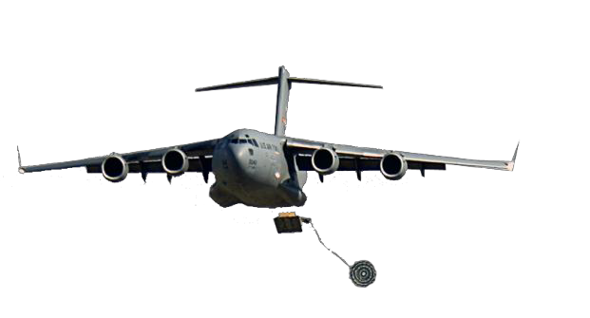
REVIEW OF THIS MATERIAL CERTIFIES THAT
HAS SUCESSFULLY COMPLETED THE
ALTUS AFB CONTRACTORS
GENERAL ENVIRONMENTAL AWARENESS TRAINING
Altus AFB eDASH: https://usaf.dps.mil/teams/10625/Altus/SitePages/Home.aspx
Name:
Date:

