Slide 1
Contractors
General Environmental Management System (EMS) Awareness
97 CES/CEIE
Environmental Element
4 September 2025
Updated: SEPT 2025

Slide 2
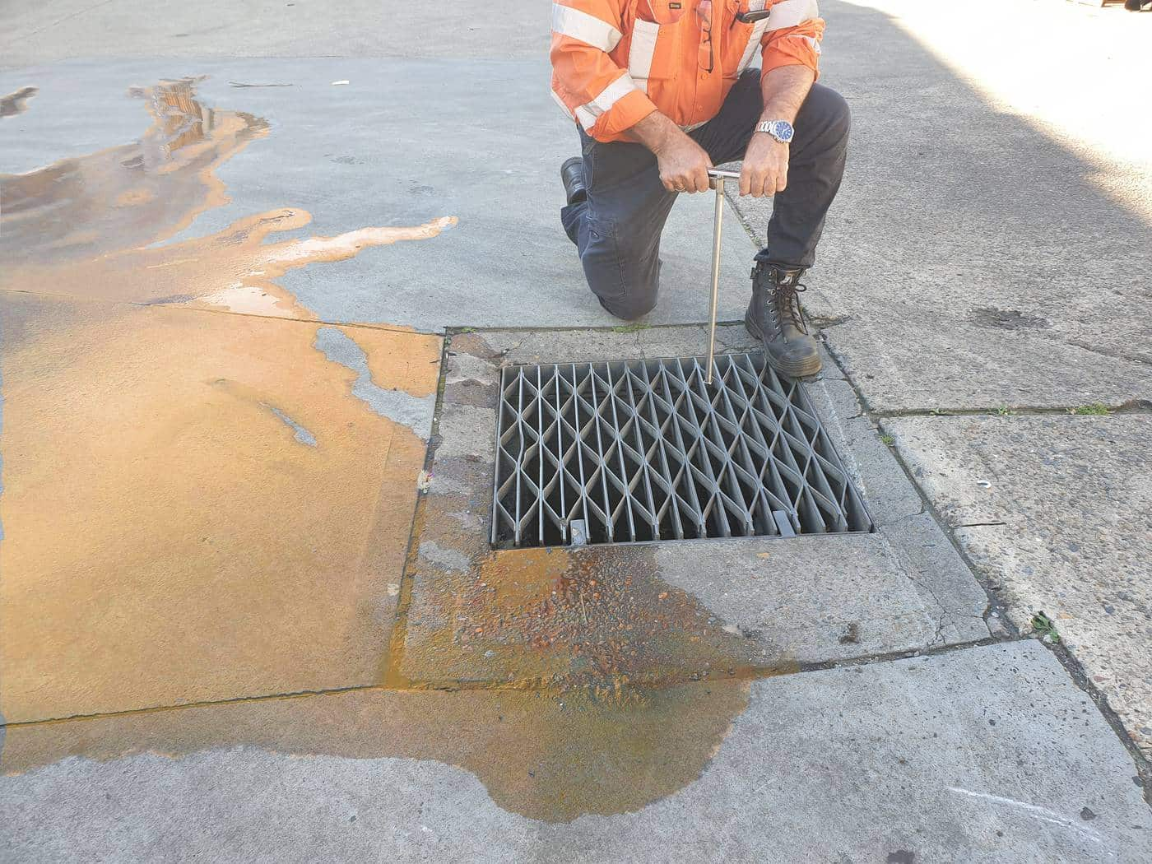
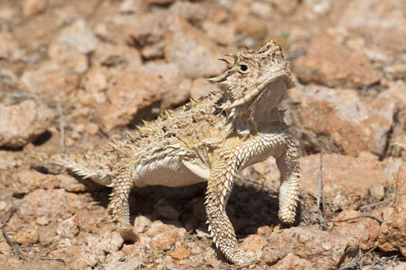
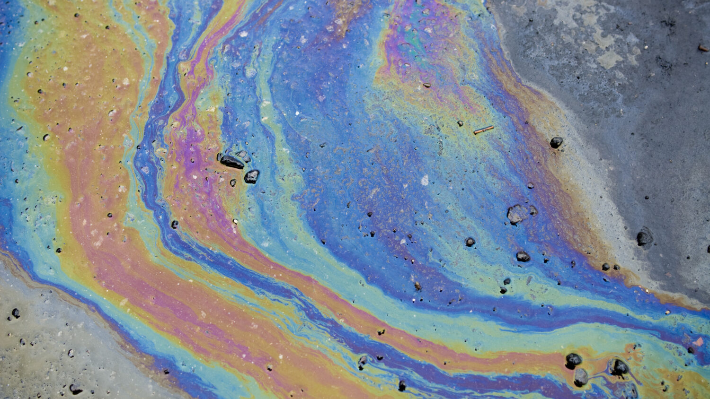

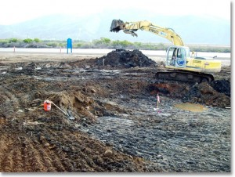
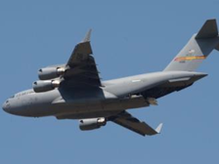
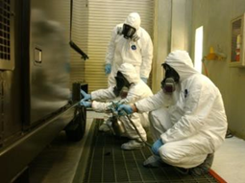
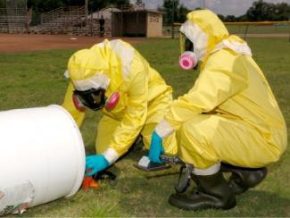
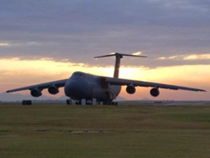
Contractor EMS Awareness
Environmental Vision/Commitment
Significant Environmental Aspects
Awareness
Attributes
Spill Reporting
Solid Waste
Questions
Conclusion
Contacts
References

Slide 3
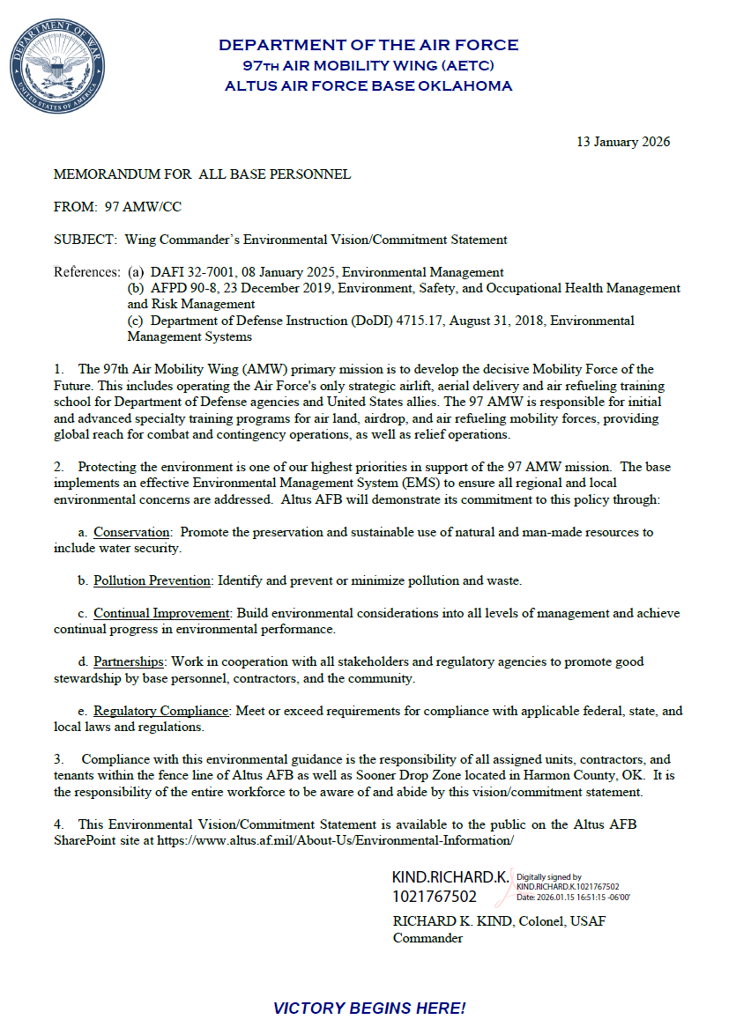
Wing Commander’s Environmental Vision
A. Conservation: Promote the preservation and sustainable use of natural and man-made resources to include water security.
B. Pollution Prevention: Identify and prevent or minimize pollution and waste
C. Continual Improvement: Build environmental considerations into all levels of management and achieve continual progress in environmental performance
D. Partnerships: Work in cooperation with all stakeholders and regulatory agencies to promote good stewardship by base personnel, contractors and the community
E. Regulatory Compliance: Meet or exceed requirements for compliance with applicable federal, state, and local laws and regulations

Slide 4
Significant Aspects & Your Role
Embrace the Base Environmental Ethos: Understand & support the Altus AFB Environmental Statement.
Master Your Contract's Green Mandates: Know & fulfill all environmental requirements within your contract.
Minimize Your Impact: Identify & proactively manage the environmental effects of your work.
Employ Best Practices: Implement BMPs (Best Management Practices) consistently for all activities.
Report Spills IMMEDIATELY: Contact Altus AFB Emergency Services for any spill or release.
Train for Environmental Excellence: Ensure all personnel are fully trained on their environmental responsibilities.
Maintain Strict Compliance: Adhere rigorously to all applicable regulations & instructions.
Prepare for the Unexpected: Know emergency contacts & procedures for swift, effective response

Slide 5
Be Aware!
Power Down: Turn off lights, monitors, & other electrical equipment when not in use.
Report Leaks Promptly: Notify the facility manager of any water leaks or waste.
Recycle Responsibly: Maximize the use of recycling bins for appropriate materials.
Never Dump Chemicals: Do NOT pour chemicals down drains.
Proper Chemical Management: Ensure all chemicals are authorized before bringing them on base, & handle, store, and dispose of them correctly.
Maintain Silt Fences: During construction, ensure silt fences are properly maintained to prevent erosion.
No Debris Around Dumpsters: Dispose of waste properly; keep dumpster areas clean.
Dispose of Waste Correctly: Dispose of batteries and fluorescent bulbs through designated channels (not in regular trash).
Be Environmentally Aware: Observe work zones for potential environmental issues & report them immediately.

Slide 6
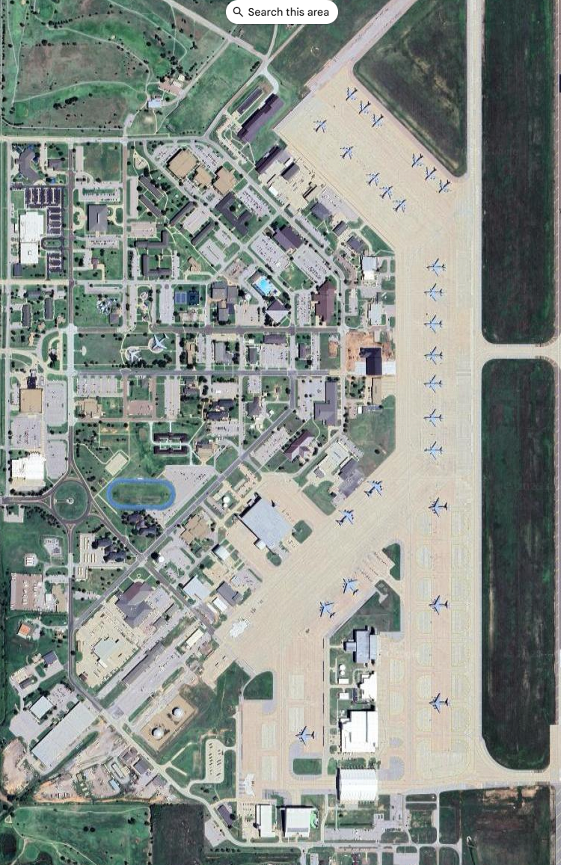
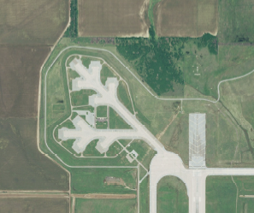
Altus AFB Environmental Attributes
8,016 acres of land
15.47 acres of Wetland
29 Restoration sites
    Land use controls (restricted digging)
537 tons/yr - Solid Waste – 51% recycled
Personnel
    2,583 Military/Dependents
    1,811 Civilians
    1,012 Retirees
0 Historic bldgs. and 1 National Registry eligible structure.
158 Air sources
4M gal fuel stored; 82 ASTs
24 tons/yr Regulated waste generated
26K containers of HazMat managed annually
Alert Apron
Altus Air Force Base

Slide 7
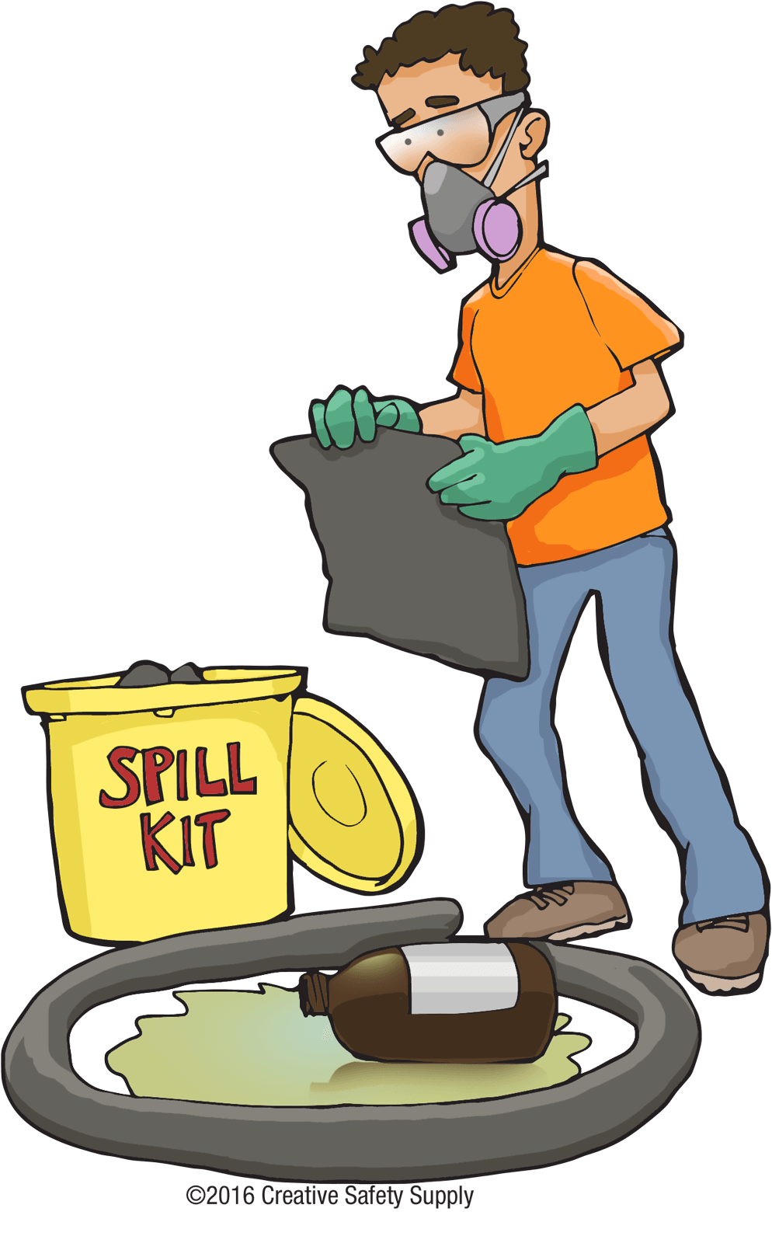
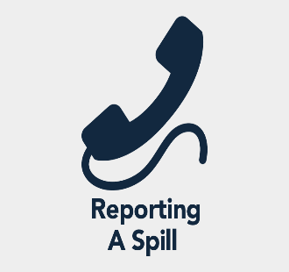
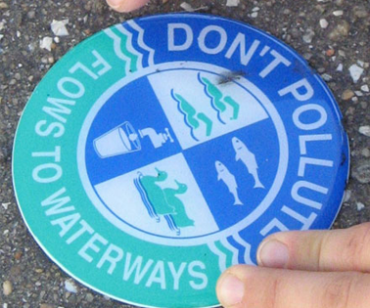
Spill Reporting
Spills, Discharges, Releases
Hazardous Waste
Water/Sewage/Industrial Wastewater
Oil/Lubricants
Fuel
Emergency number from your cell phone:
580-481-6333 (Fire Dept)
Contact/Report Immediately:
For any spill, discharge, or releases that:
  Occur outside
  Enters a storm/sanitary drain
  Reaches soil
Nothing other than clean water can enter a storm drain
Call
911
Link to spill report form:
https://usaf.dps.mil/:w:/r/teams/10625/Altus/_layouts/15/Doc.aspx?sourcedoc=%7BC05ADD67-4AF1-4022-9C15-50E10264D63A%7D&file=Altus%20AFB%20Spill%20Report%20Form%202021.docx&action=default&mobileredirect=true

Slide 8
Solid Waste Management
RECYCLABLE ITEMS:
While Cardboard (break down) and Paper (bagged) are required by DOD regulation at Altus AFB we additionally recycle various types of metals, #1 & #2 plastics, and used toner cartridges. These items must not be thrown into any dumpster.
  Aluminum & Tin cans and other Metals
  Plastics - #1 or #2 plastics
    Pallets- TAKE TO ROLL OFF
    Batteries (Lithium Ion, Nickel Cadmium, Nickel Metal
    Hydride, Small (under 2 lbs) sealed lead and lead acid)
    Empty Aerosol Spray Cans
KEY
Must be taken to
Recycle Center (0700-
1600)
Altus AFB Mandatory
recyclables by DOD
Regulation
Notes:
We don’t recycle:
Food or other contaminants
Carbons
Waxed paper
Plastic coated paper
Cellophane
Wood
stryofoam

Slide 9
Questions
Can anything other than clean water enter the storm drain?
    a. No
    b. Yes
Who authorizes a work center to store Universal Waste?
    a. 97 CEIE, Environmental Element
    b. Squadron Commander
    c. Facility Manager
    d. No authorization required.

Slide 10
Questions
3. Which of the listed products is NOT recycled on Altus AFB?
    a. Glass
    b. Cardboard
    c. Paper
    Scrap Metal
What is the FIRST number you should call to report a hazardous material spill or environmental incident that poses an immediate threat to life, health, or the environment?
  911
  1(800)Dominos
  411
  481-6221

Slide 11
Questions
Does the installation have an Air Permit?
a. No
b. Yes
What material(s) are MANDATORY at Altus AFB by DOD Regulation?
    a. Cardboard and Paper
    Glass and Plastic
    Cardboard and Plastic
    d. Paper and Plastic

Slide 12
Questions
7. When should you call to report a spill?
  Immediately
  Within 24 hours
  Within the hour
  The next business day
8. What must a contractor track regarding construction and demolition (C&D) materials?
a) Only the location of the disposal facility.
b) Only the tonnage of material sent to a disposal site.
c) The location and tonnage of disposed material, as well as any materials diverted from disposal for reuse or recycling.
d) The total cost of all materials, whether disposed of or recycled.

Slide 13
9. What is the deadline for a contractor to submit their monthly waste management report?
a) By the 5th calendar day of the following month.
b) No later than the 5th working day after the end of the month.
c) On the last working day of the month.
d) Within the first week of the project's start.
10. According to the Construction and Demolition (C&D) requirements, when must a contractor develop a waste management plan?
a) By the 5th working day after the project starts
b) After the project is completed
c) Prior to the project start date
d) Within 30 days of contract award

Slide 14

Takeaways!
EMS: Part of Your Everyday Role: Environmental stewardship is integrated into your daily tasks.
Your Actions Shape Compliance: Your choices directly contribute to the base's environmental performance.
Reduce Risks, Reduce Costs: EMS helps you identify and mitigate environmental risks, saving valuable resources.
Boost Operational Excellence: Implementing EMS principles improves overall efficiency and effectiveness.
A Win for All: EMS benefits both you and the entire installation, creating a sustainable future.
You Control Your Impact: Ultimately, you have the power to manage and minimize your environmental footprint.

Slide 15
Lori Stevens
Element Chief
Air/Tanks/Toxics Program Manager
Office: 580-481-7605 lori.stevens.2@us.af.mil
Point of Contact
Lainey Kelley
Natural/Cultural Resources Program Manager
Office: 580-481-7606
delaine.kelley.1@us.af.mil
Dan Staton
Hazardous Materials Site Manager
Office: 580-481-6198
dan.staton.1.ctr@us.af.mil
Heath Sirmons
Water Quality/NEPA Program Manager
Office: 580-481-7609
jimmy.sirmons@us.af.mil
Katie Cichy
HAZMAT/HAZWASTE Program Manager
Office: 580-481-6110
kathryn.cichy@us.af.mil
Danika Toole
EMS/QRP/SW Program Manager
Office: 580-481-6221
Cell: 580-471-6436
danika.toole@us.af.mil
Mike Ruhl
Environmental Restoration Program Manager
Office: 580-481-7346
michael.ruhl.2@us.af.mil

Slide 16
Air Force Instructions &
Local Environmental Regulations
Environmental Management falls under Civil Engineering and follows 32-series DAFIs various base specific plans and permits.
Plans/Permits | Title
Pest Management | Integrated Pest Management Plan
Natural Resources | Integrated Natural Resources Management Plan
Cultural Resources | Integrated Cultural Resources Management Plan
Solid Waste | Installation Solid Waste Management Plan
Hazardous Waste | Hazardous Waste Management Plan
Hazardous Materials | Hazardous Materials Management Plan
SWPPP | Storm Water Pollution Prevention Plan
ICP | Installation Contingency Plan
Asbestos | Asbestos Management & Operations Plan
Lead Based | Lead-Based Paint Management & Operations Plan
Air Permit | Minor Source Operating Permit 2016-1031-0 (M-3)
Storm Water Permit | OPDES Multi-Sector General Permit OKR05 (2017)
Wastewater Discharge | Wastewater Discharge Permit 02-17
DAFI / DAFMAN | Title
32-7002 | Environmental Compliance & Pollution Prevention
32-1052 | Facilities Asbestos Management
32-7003 | Environmental Conservation
32-7001 | Environmental Management System
32-7061 | National Environmental Policy Act/Environmental Impact Analysis Process
32-7047 | Environmental Compliance, Release, and Inspection Reporting
32-7044 | Storage Tank Environmental Compliance
32-1067 | Water Systems

Slide 17
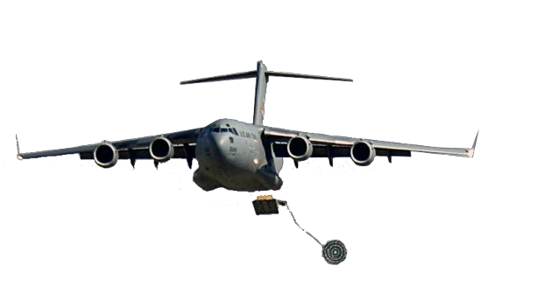
REVIEW OF THIS MATERIAL CERTIFIES THAT
HAS SUCESSFULLY COMPLETED THE
ALTUS AFB CONTRACTORS
GENERAL ENVIRONMENTAL AWARENESS TRAINING
Altus AFB eDASH: https://usaf.dps.mil/teams/10625/Altus/SitePages/Home.aspx
Name:
Date:

